Slide 1
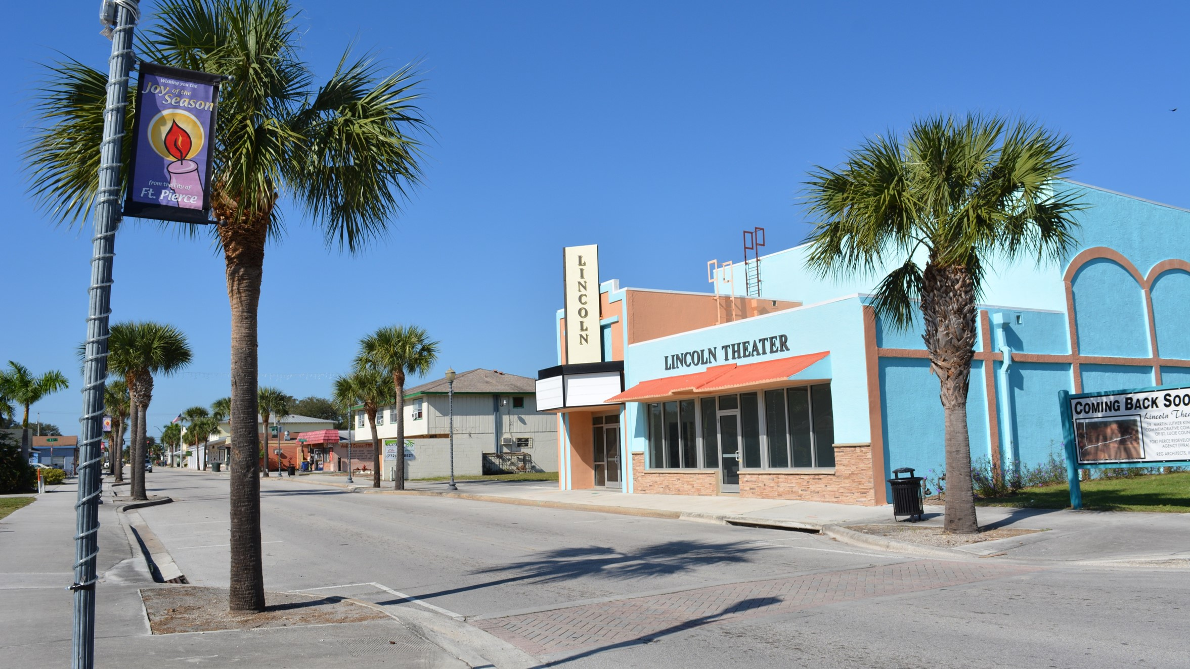
Strategy & Vision for the
Revitalization of
Lincoln Park
Conference Agenda Presentation • September 10, 2018

Slide 2
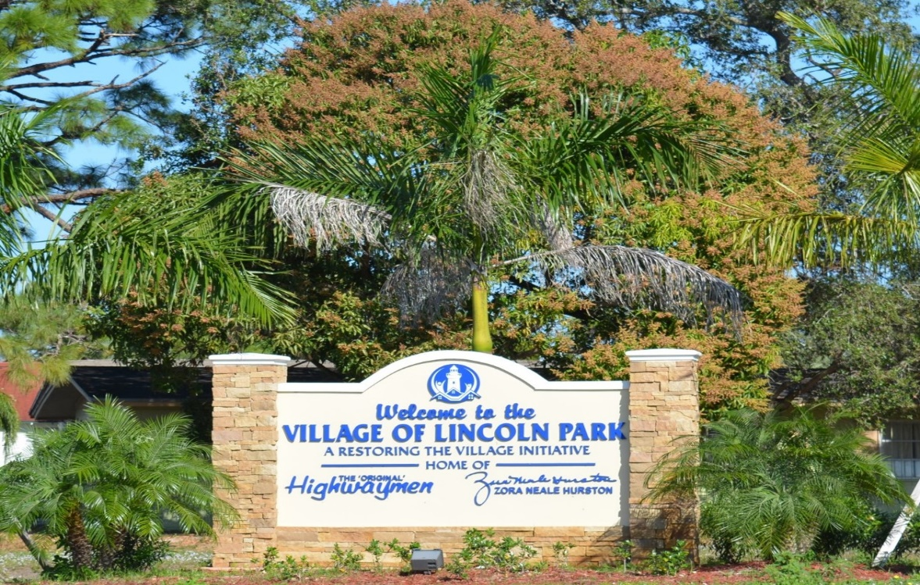

OUTLINE
INTRODUCTION/OVERVIEW
ACTIVITY GENERATION
REVITALIZATION COORDINATOR UPDATE
ECONOMIC DEVELOPMENT
PARTNERSHIPS
NEXT STEPS

Slide 3
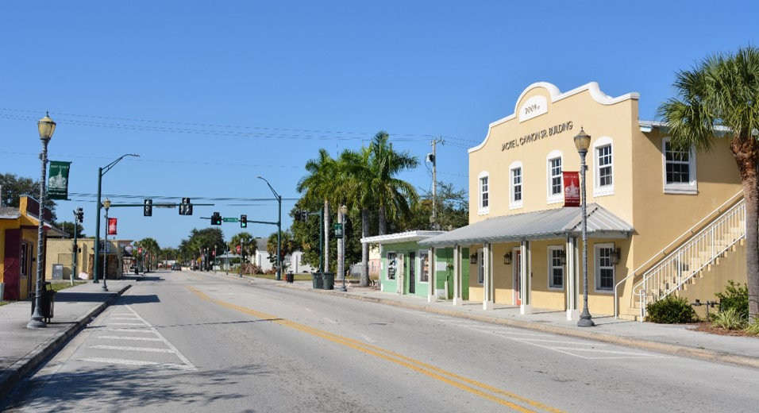
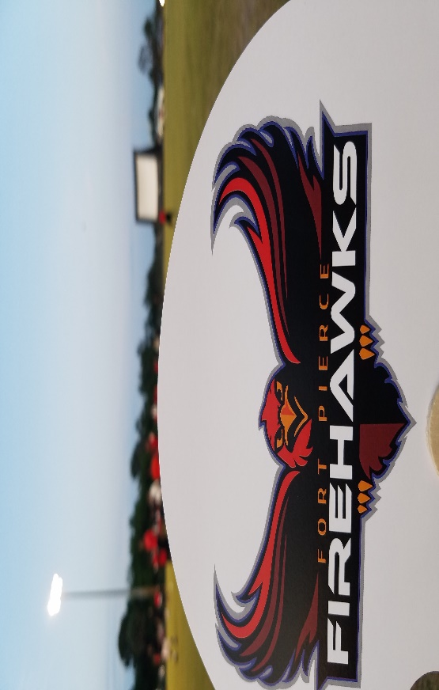
OBJECTIVES
Lincoln Park Revitalization
Communicate the “vision” of the district and implementation phases.
Clearly identify the boundaries and highlight the proximity to the surrounding amenities and districts.
Strengthen the connections between the key cultural facilities and community partners.
Improve opportunities for frequent and meaningful activity and contact among citizens.
Highlight initiatives that promote a sense of comfort and safety.
Create an attractive environment to encourage private investment and one that builds and supports economic development.
Make it easy to do business in Lincoln Park.

Slide 4
Lincoln Park Revitalization Coordinator
Caleta Scott
September 5, 2017
Representation:
Council on Social Agencies
Healthy St Lucie/Food Policy Council
Workforce Readiness Task Force
UF/IFAS Extension CRD Advisory Council
Lincoln Park Main Street
Hurricane Irma Recovery Efforts
Percy Peek Gymnasium shelter
Keep Fort Pierce Beautiful
Focus on Community Gardens
Homeless Resource Center
SLC/FPHA/In the Image of Christ
Sister Cities International
Bahamian Consulate visit
MLK Commemorative Committee
Lincoln Theater Renovation
Zora Neale Hurston Committee
Zora Fest/Tourism
INFILL Development
Community Land Trust
Arts and Culture Master Plan/Advisory Board
Mural Program
PAD Visioning Team

Slide 5
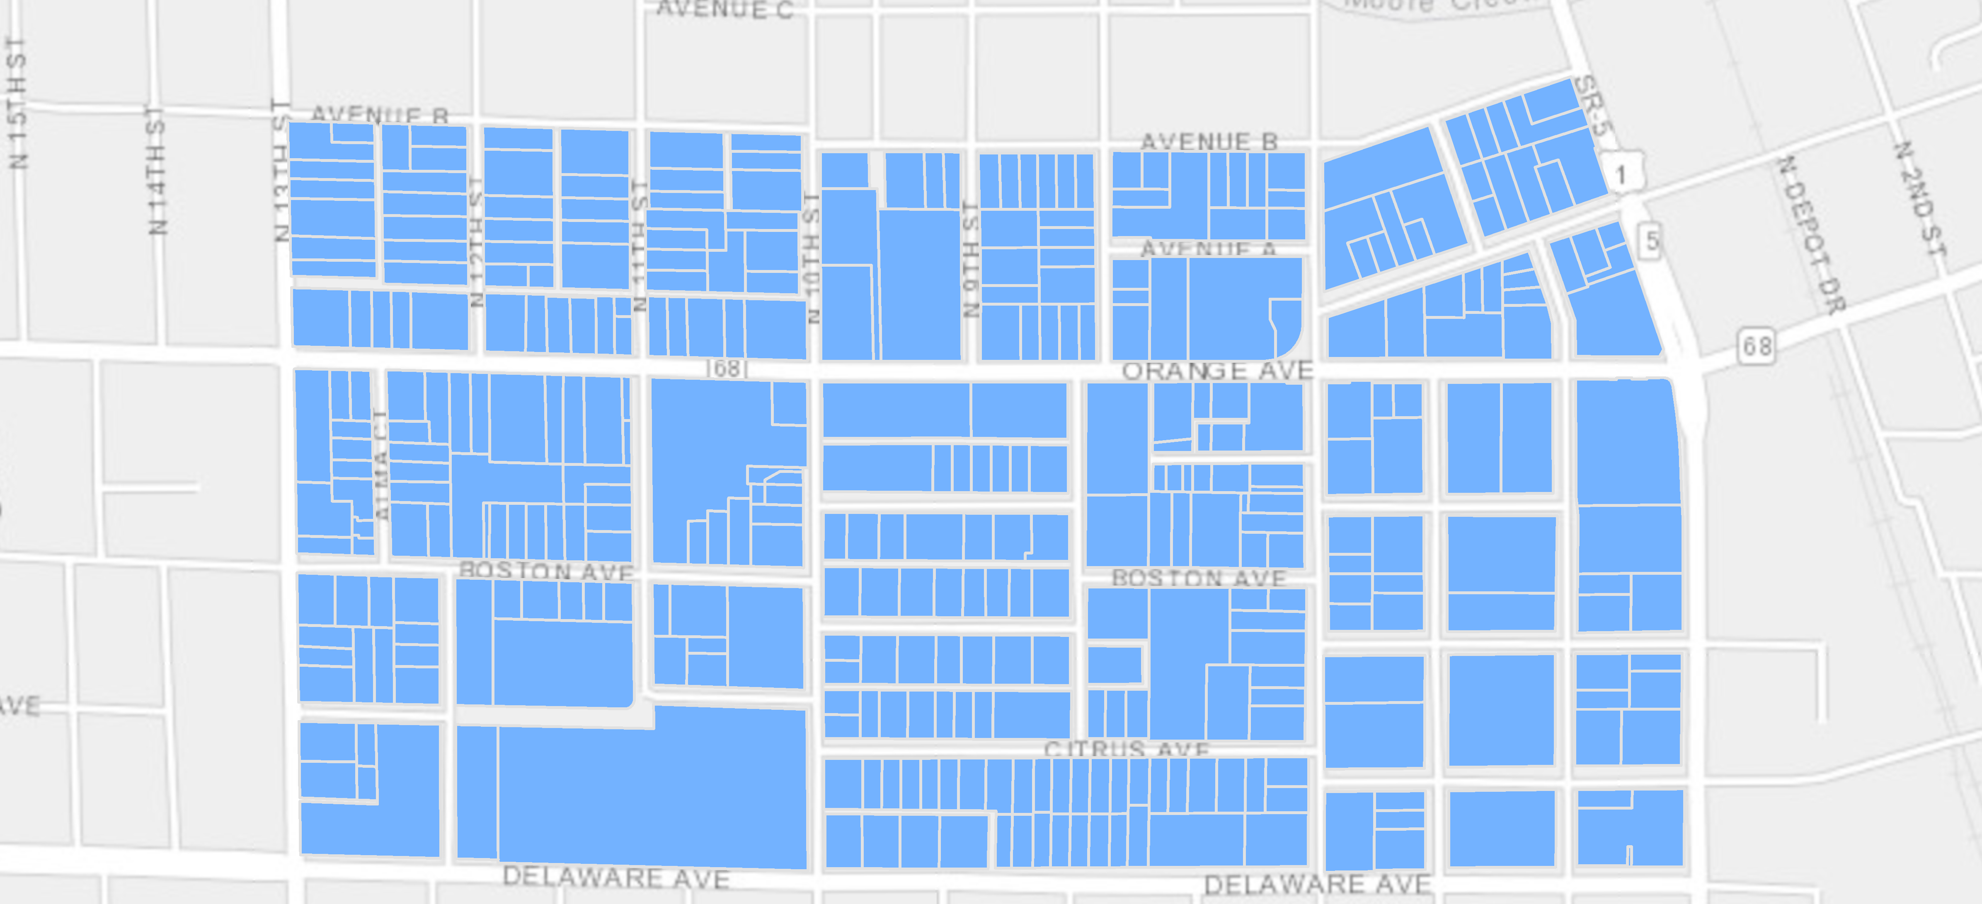
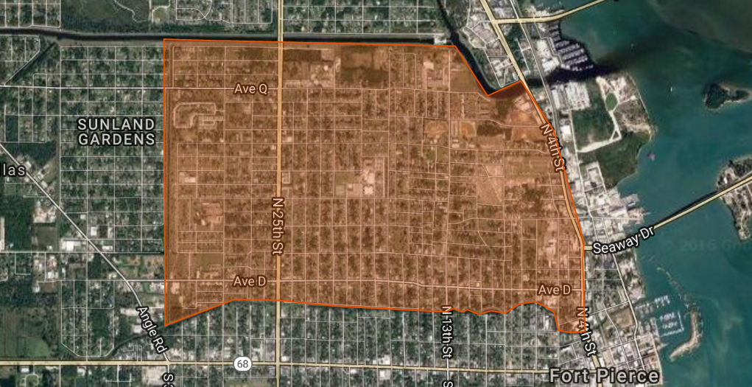
BOUNDARIES
Formerly known as the
Northwest section of Fort Pierce.

Slide 6
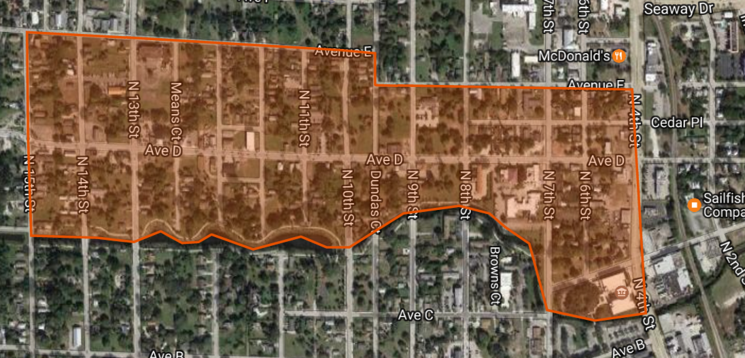
Historic Avenue D Business District
Bring back the thriving economic center that was the Avenue D corridor.

Slide 7
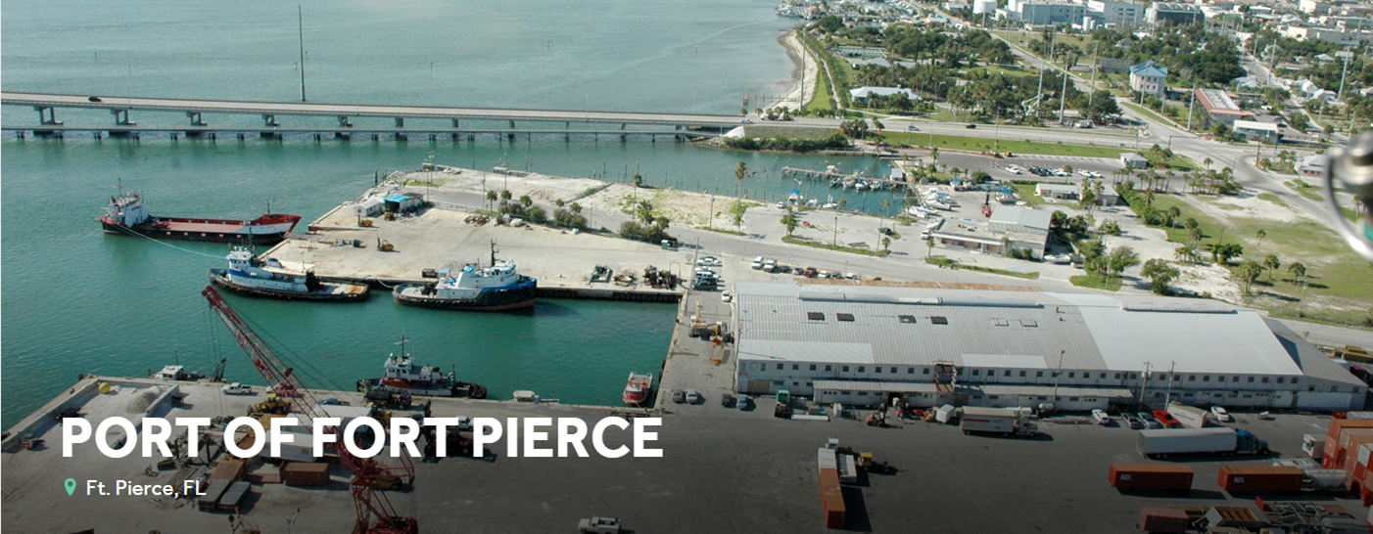
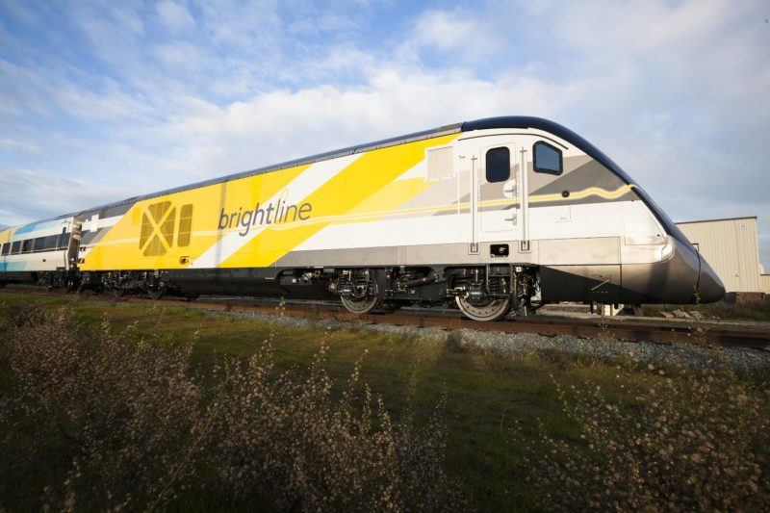
COMING SOON! – Port of Fort Pierce Development
Lincoln Park residents will have access to quality jobs and livable wages
POSSIBILITIES ABOUND!?!?!
Lincoln Park neighborhood is PRIME due to its proximity to a walkable downtown, beautiful waterfront and multi-modal transportation.

Slide 8
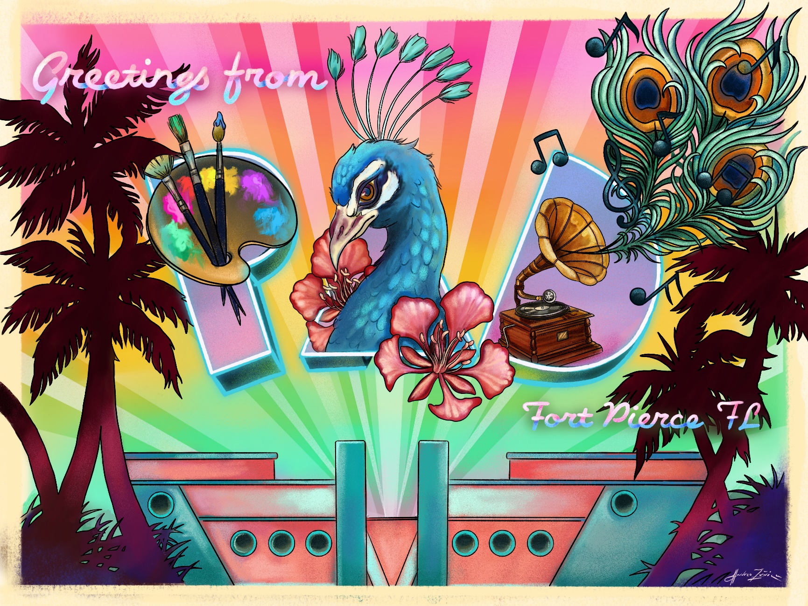
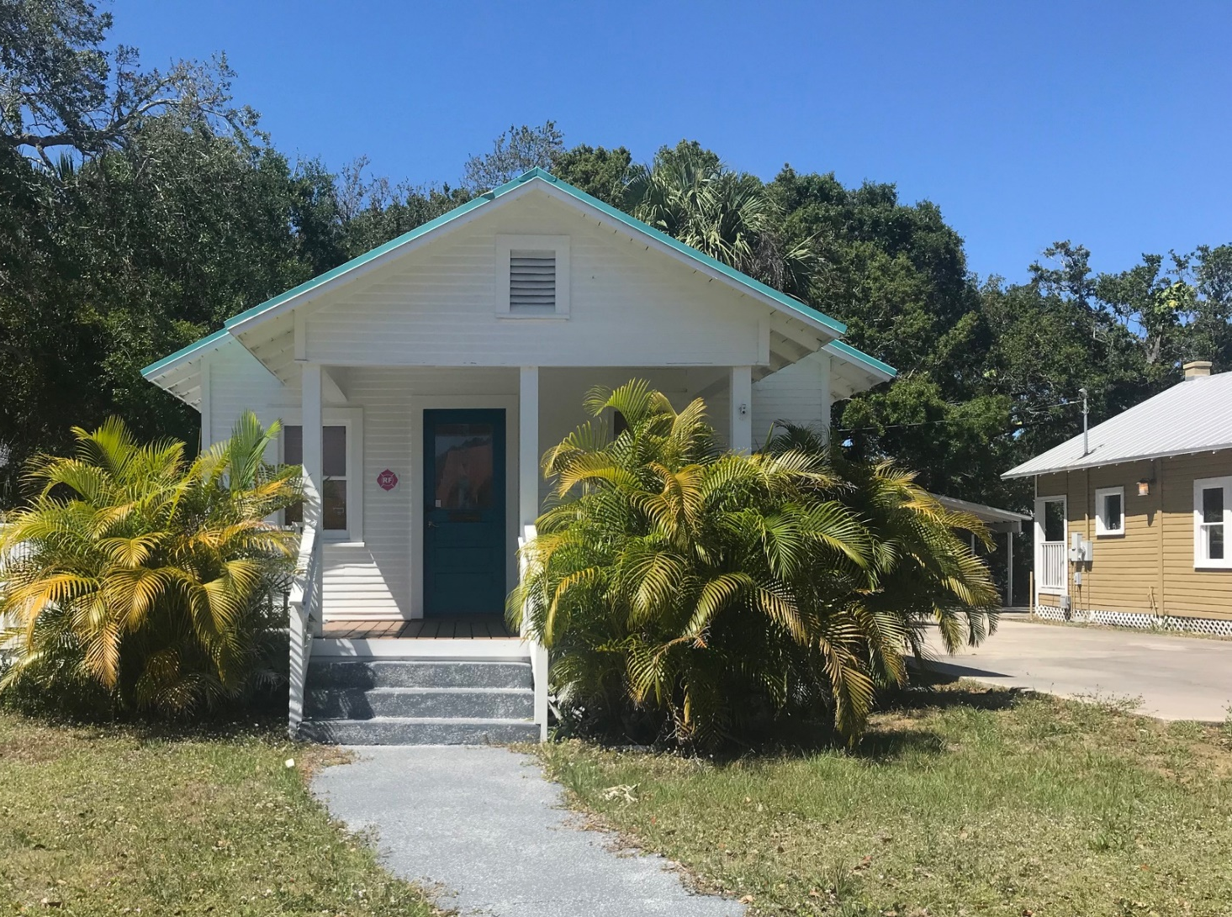


PROUD TO BE IN THE PAD
BUT FIRST, LET ME TAKE A SELFIE.
Selfie spot designed by local artist, Andy Zuniga
7th Street and Avenue A

Slide 9
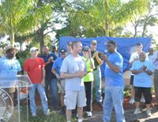
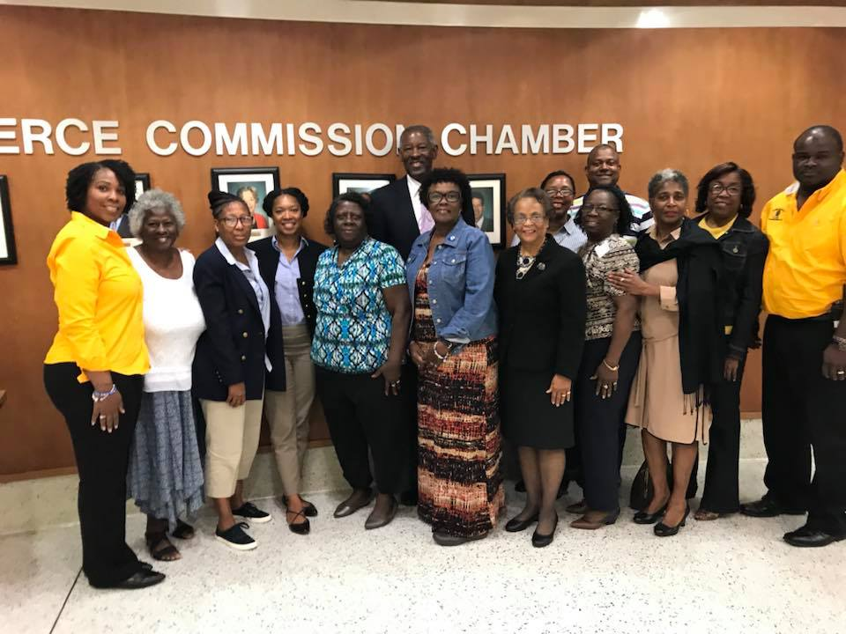
OBJECTIVE: Strengthen the connections between the key cultural facilities and community partners.
PARTNERSHIPS

Slide 10
Lyft blog vegan ramps
ABOUT US
PARTNERSHIPS
St Lucie County
St. Lucie Public Schools
Indian River State College
Economic Development Council
Fort Pierce Utilities Authority
Fort Pierce Housing Authority
Career Source Research Coast
Lincoln Park Main Street
Public Service Agencies
Local Business Community
Common Good Initiative
COMMUNITY

Slide 11
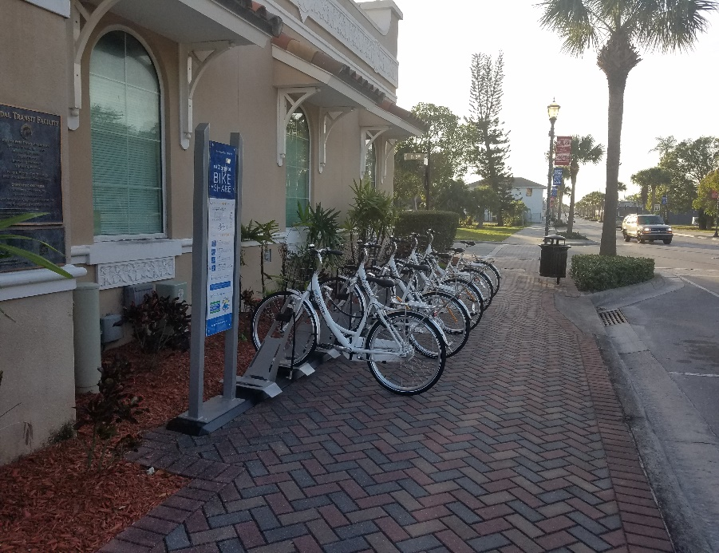
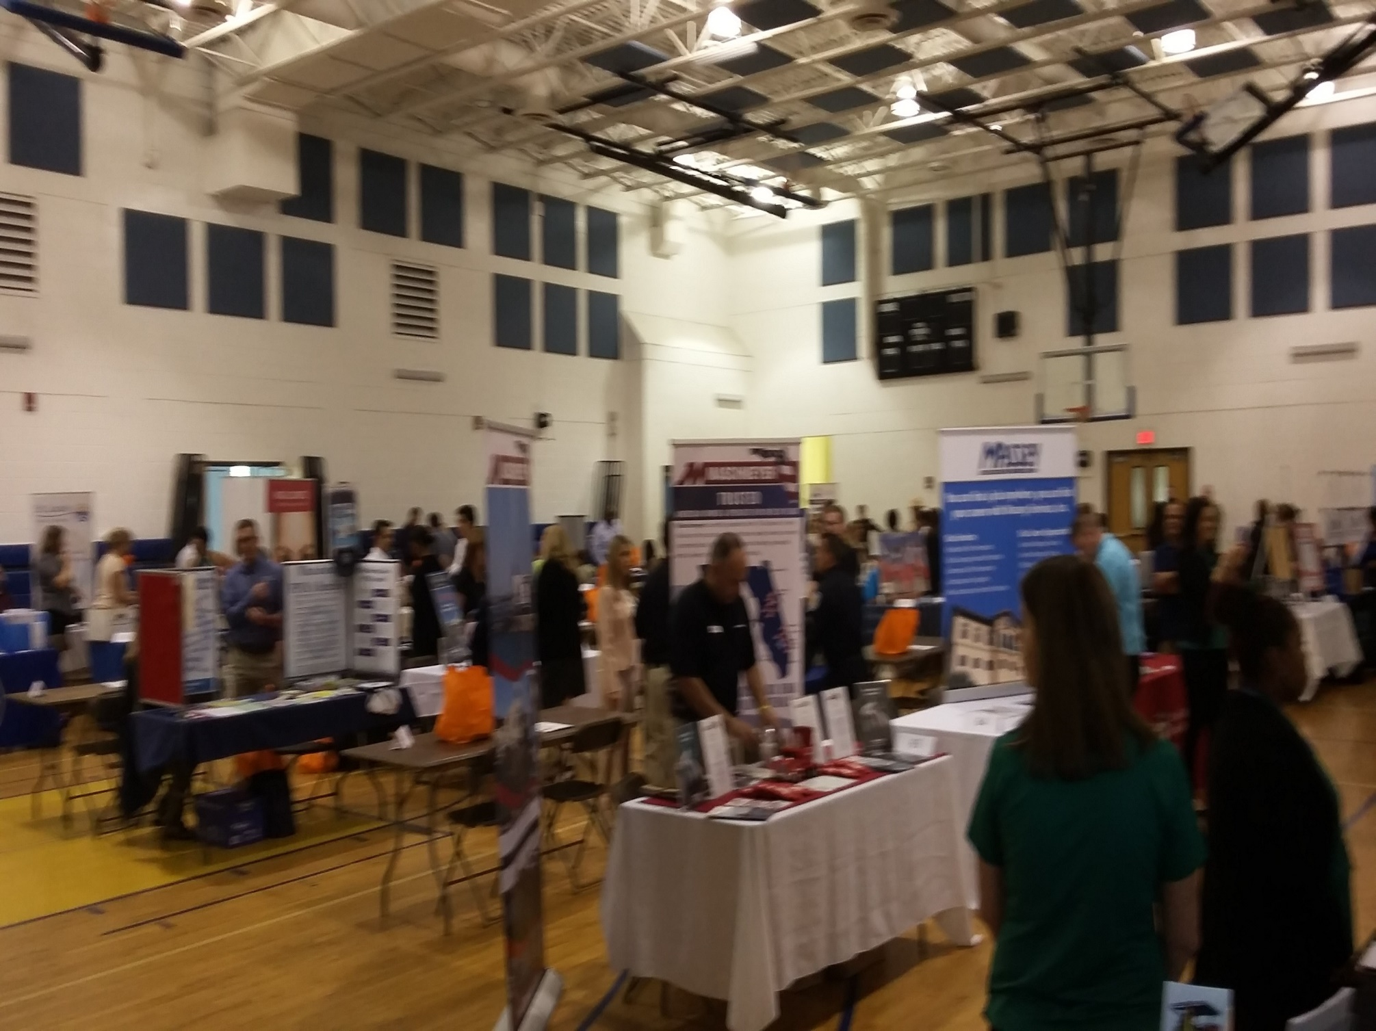
Annual Job Fair - CSRC
January 30, 2019
Public Service Agency Grants – CDBG Funding
World Changers / Paint Our Town
Job Training with Career Source and IRSC
Bike Share Program at Intermodal Station – SLC Transit

Slide 12
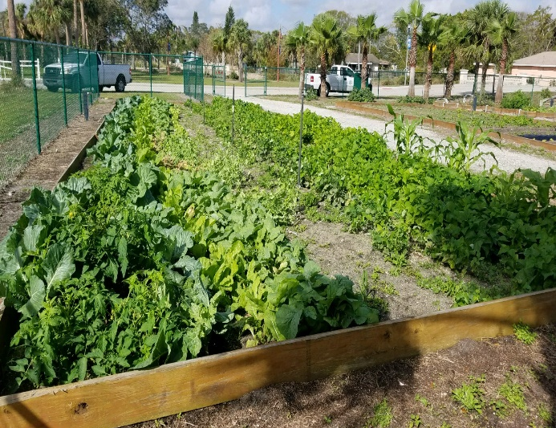
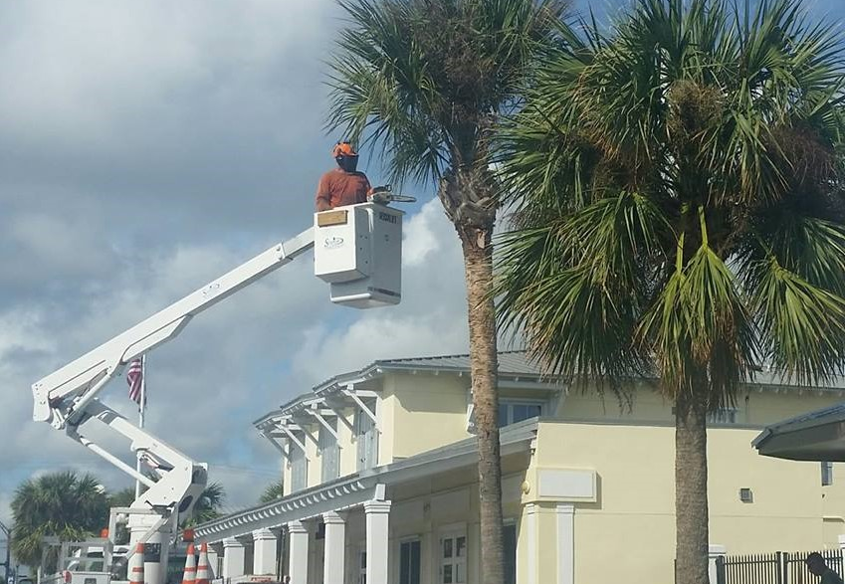
OBJECTIVE: Highlight initiatives that promote a sense of comfort and safety.
BEAUTIFICATION

Slide 13
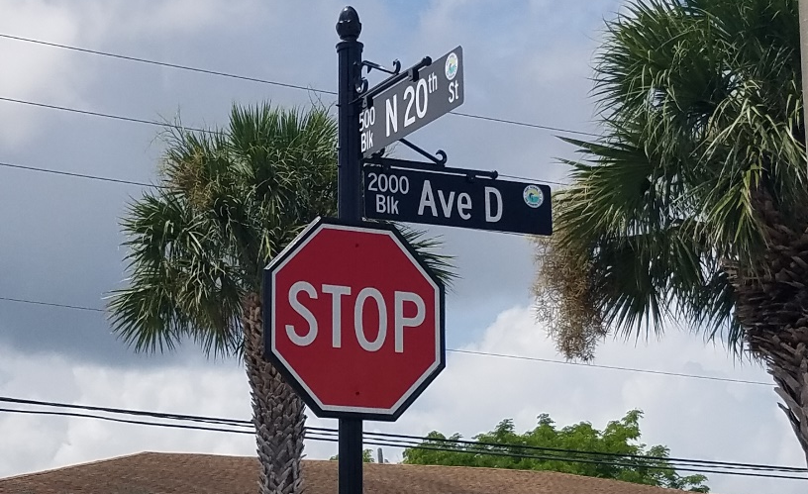
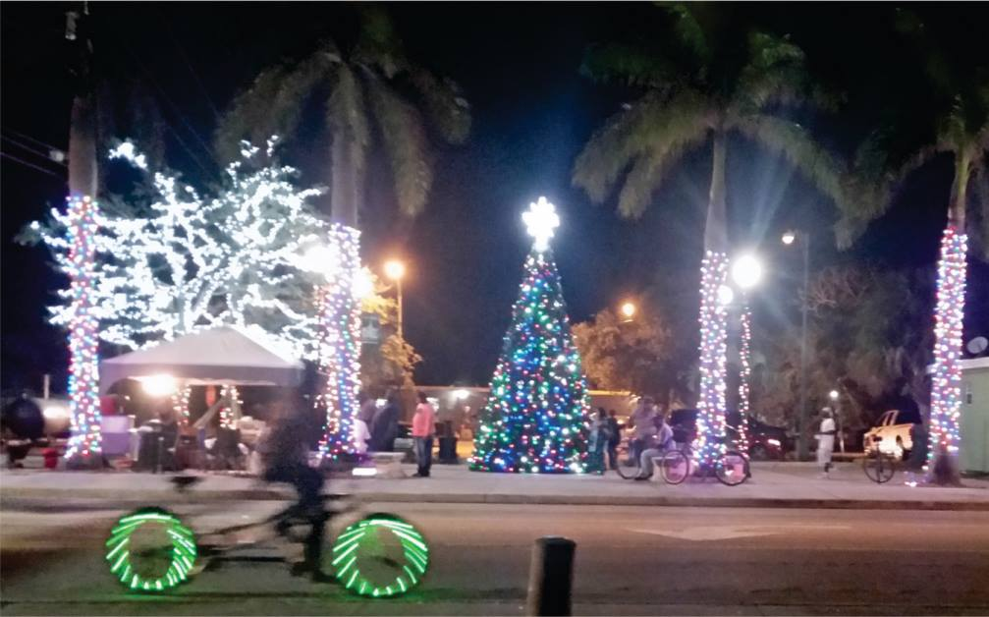
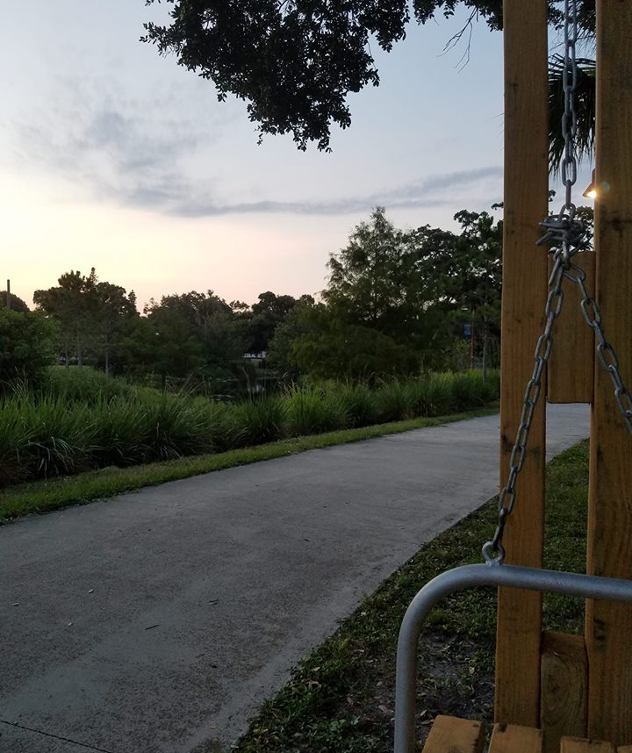
BEAUTIFICATION
#LightUpLincolnPark #LincolnParkProud

Slide 14



Future Garden Sites in Lincoln Park:
Garden City Elementary - CSRC
Zora Neale Hurston Library - FPHA
Means Court School - SLPS
Ray’s Community Garden – 23rd and Ave G
Small parcel projects
Gardening Season Kickoff!
End of October
CALL FOR ENTRIES
Crime Prevention – Education – Food Production – Health & Wellness – Green Space – Community Organization

Slide 15
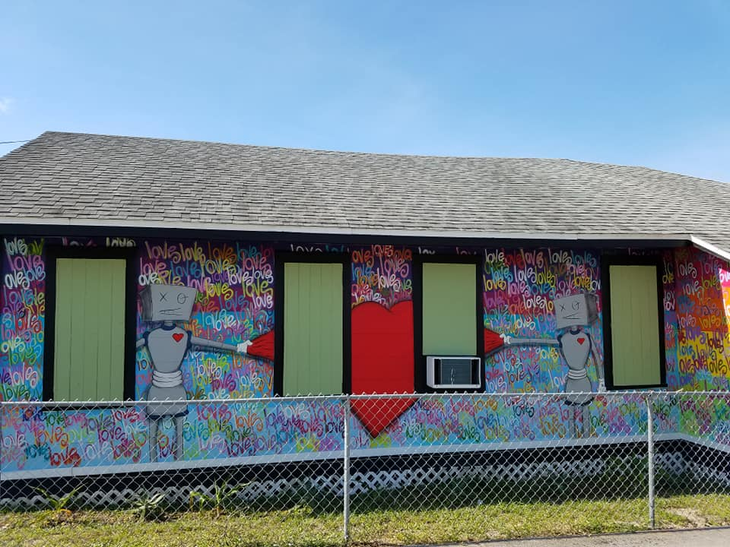
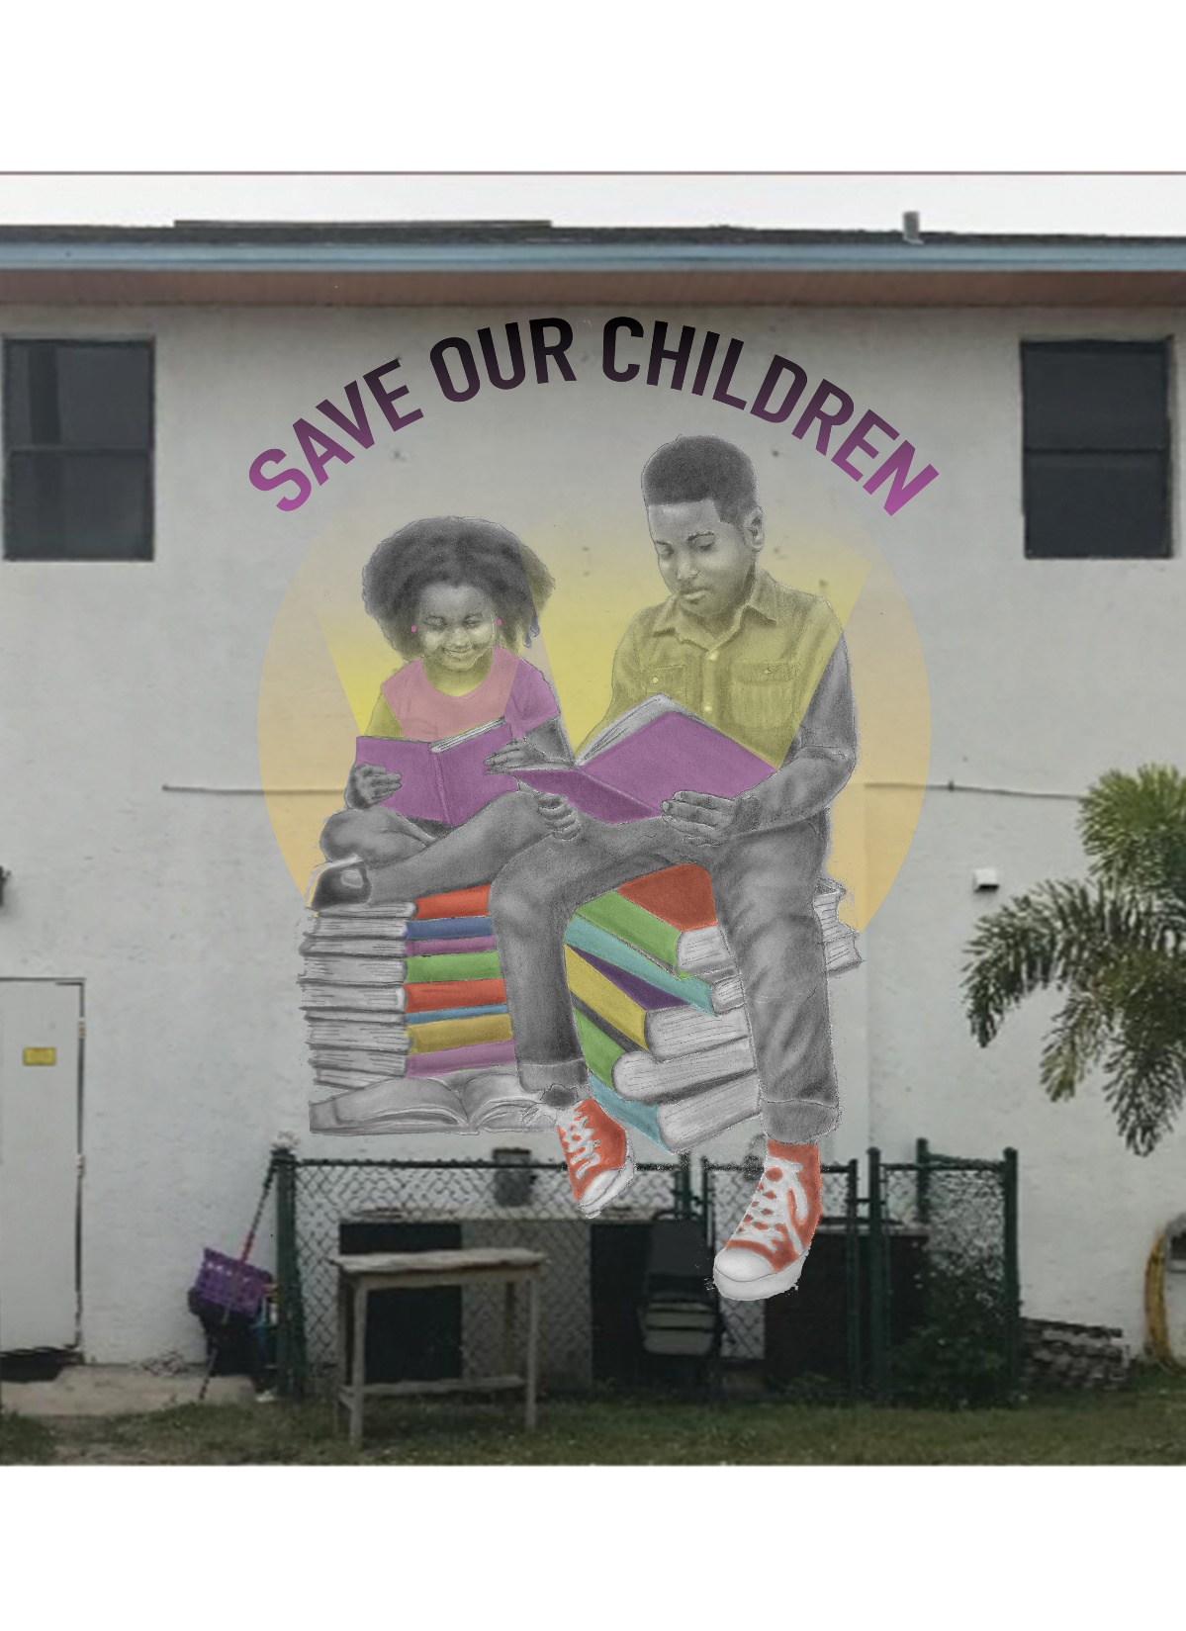
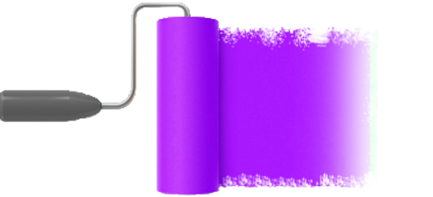
MURAL PROGRAM
Approved Lincoln Park
Mural Projects:
464 N 6th Street – Completed
464 N 9th Street – In progress
510 N 13th Street – Mid Sept
More to come…

Slide 16
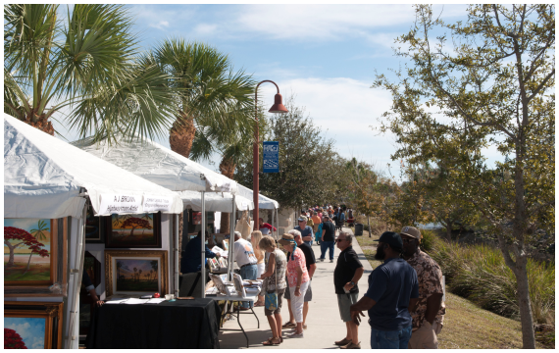
OBJECTIVE: Improve opportunities for frequent and meaningful activity and contact among citizens by creating places that attracts a diverse population
ACTIVITY
GENERATION

Slide 17

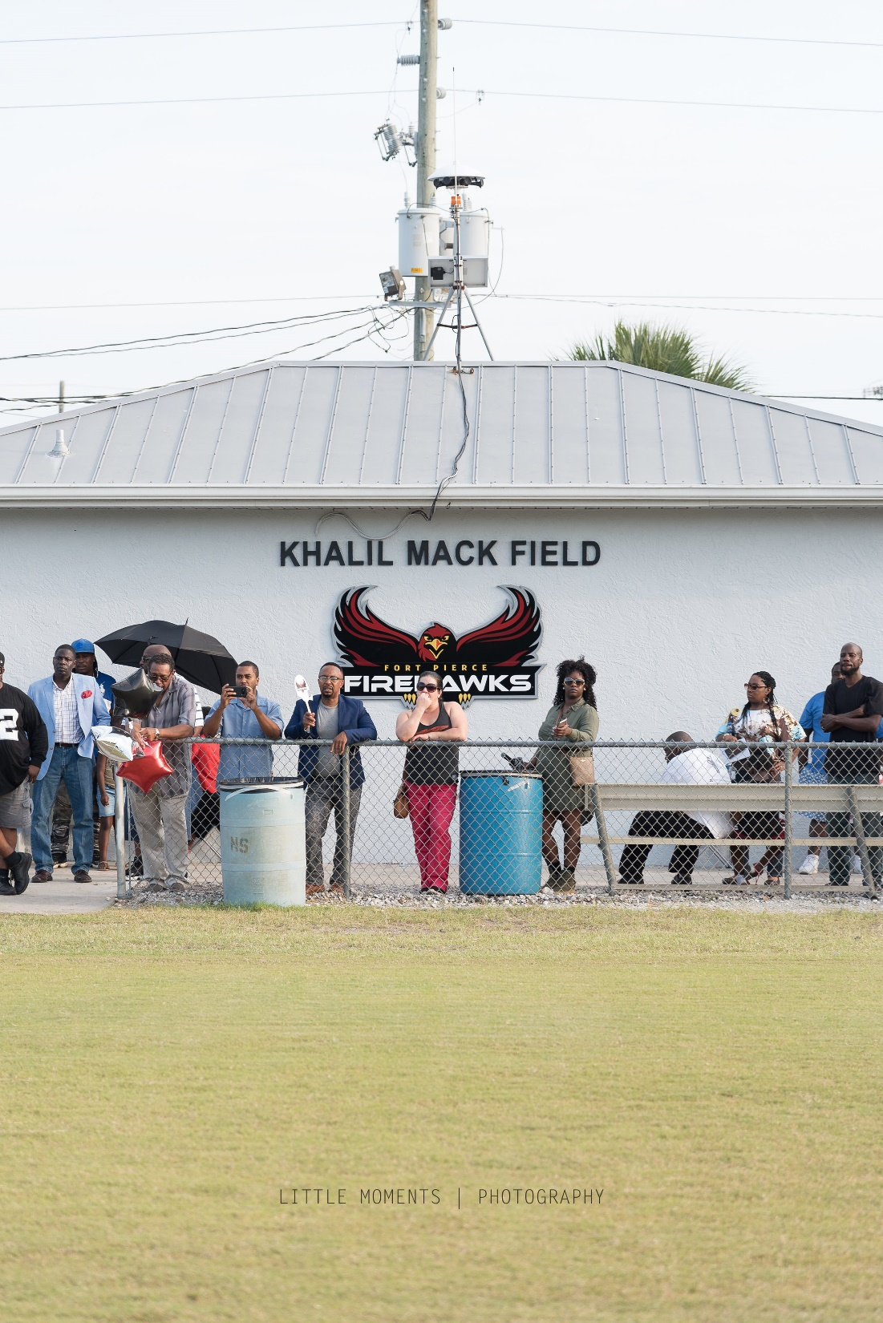
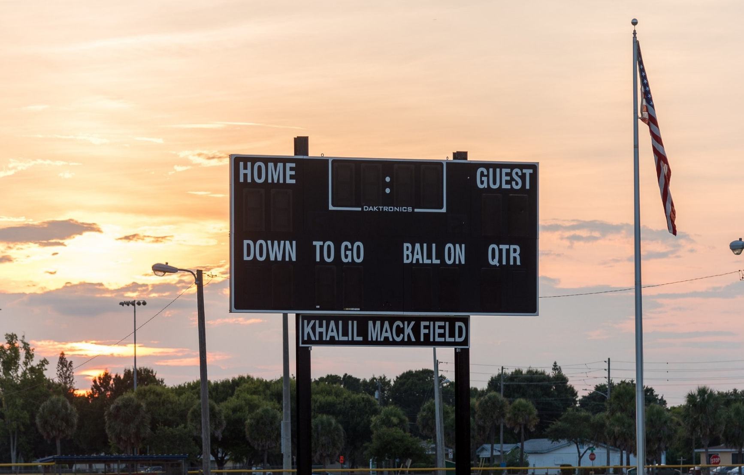
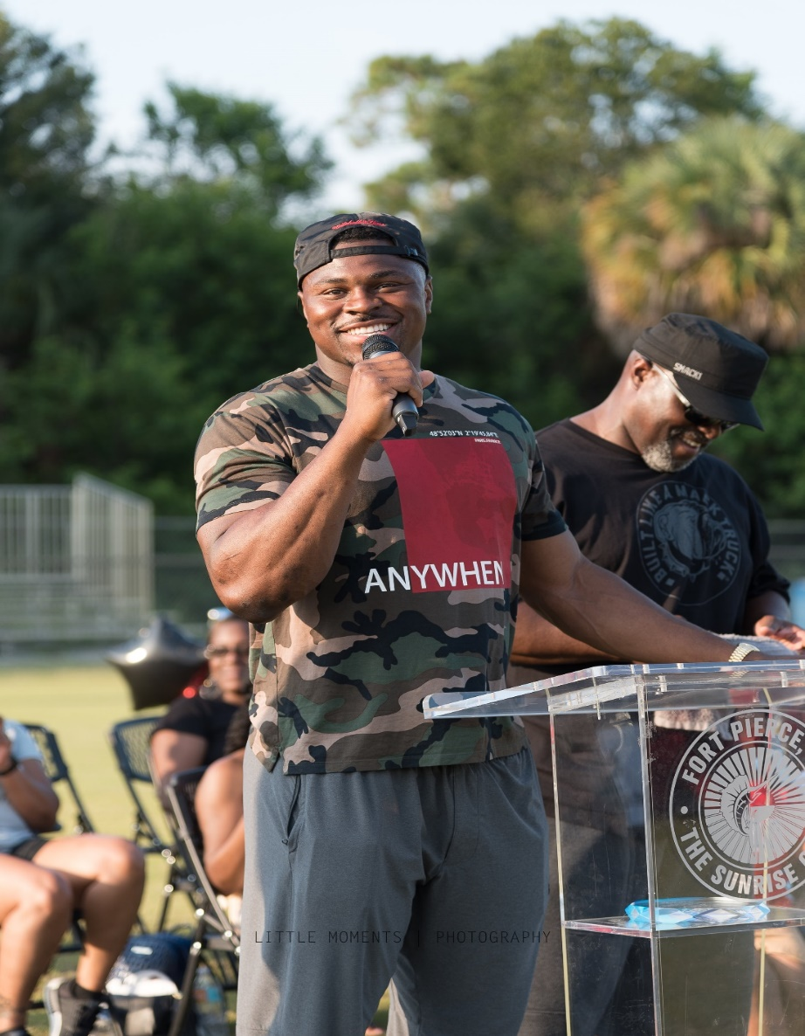
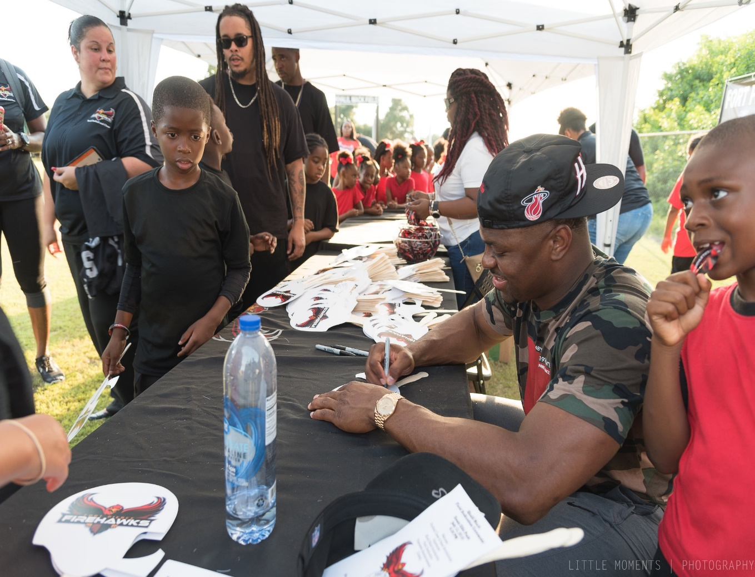
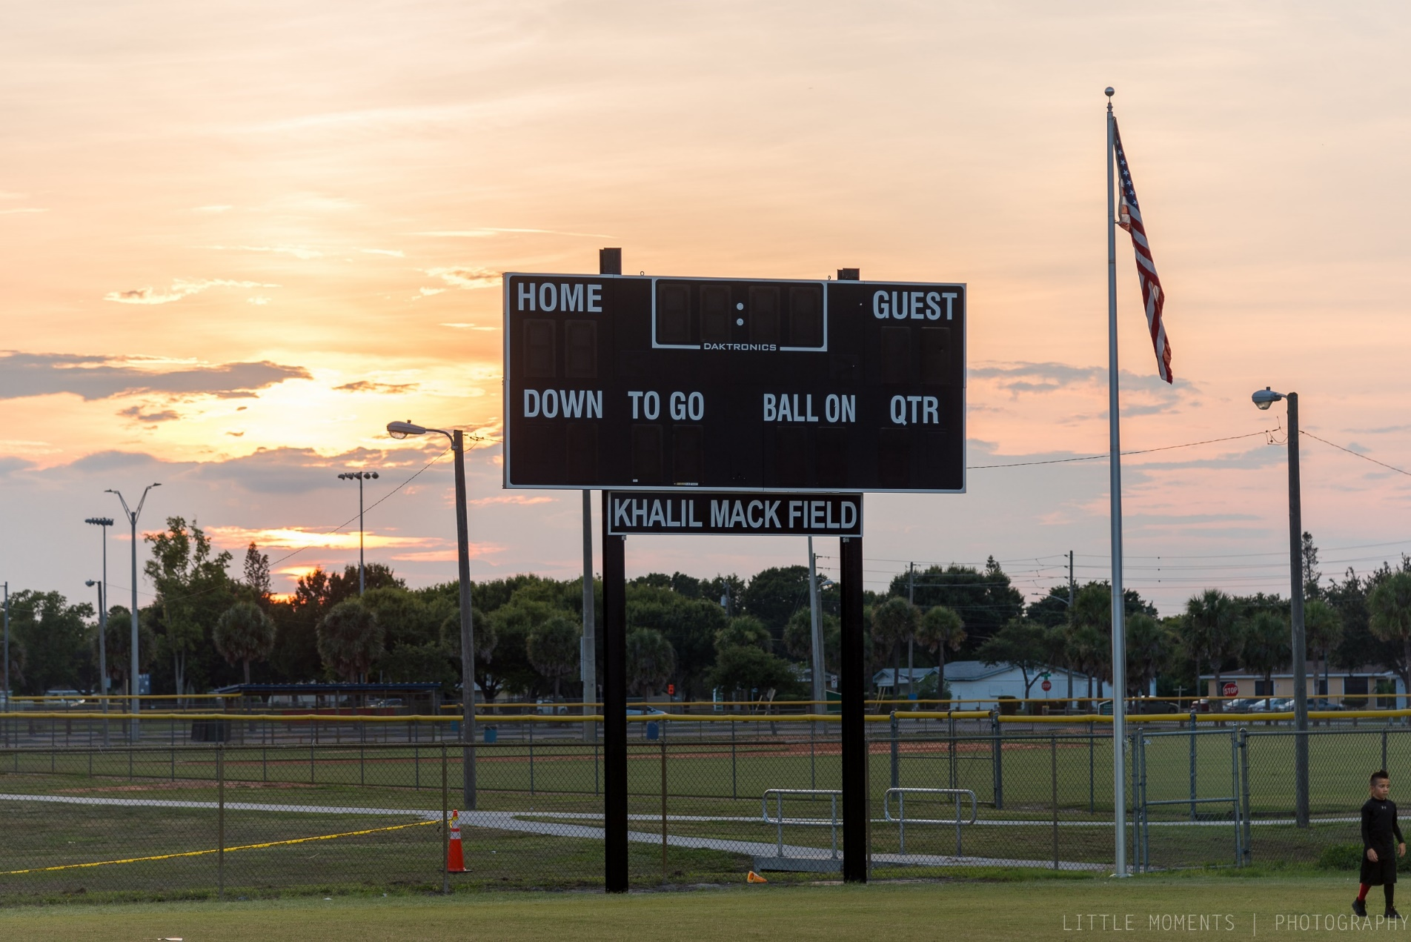

Khalil Mack Field Dedication @ Lincoln Park Regional Park
Friday, July 13, 2018

Slide 18


Event Collaboration
Lincoln Park Main Street to update Jazz on Moore’s Creek quarterly event
Zora Neale Hurston Committee to take a new look at Zora Fest! Nov 1 – 4, 2018

Slide 19
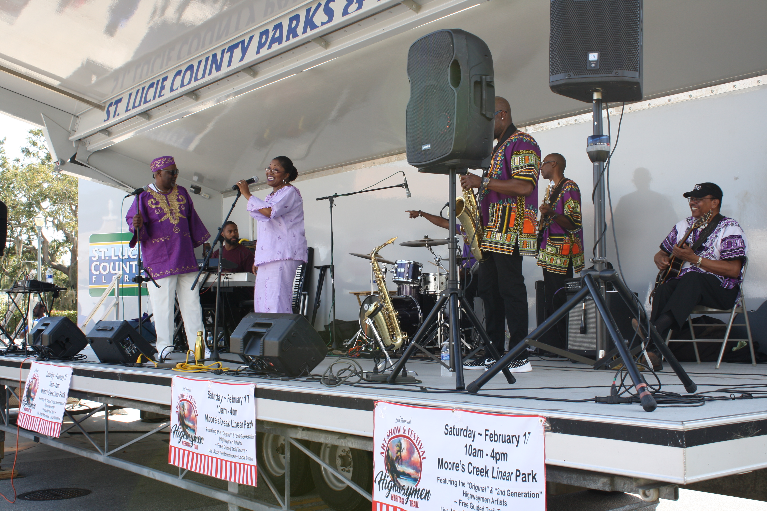
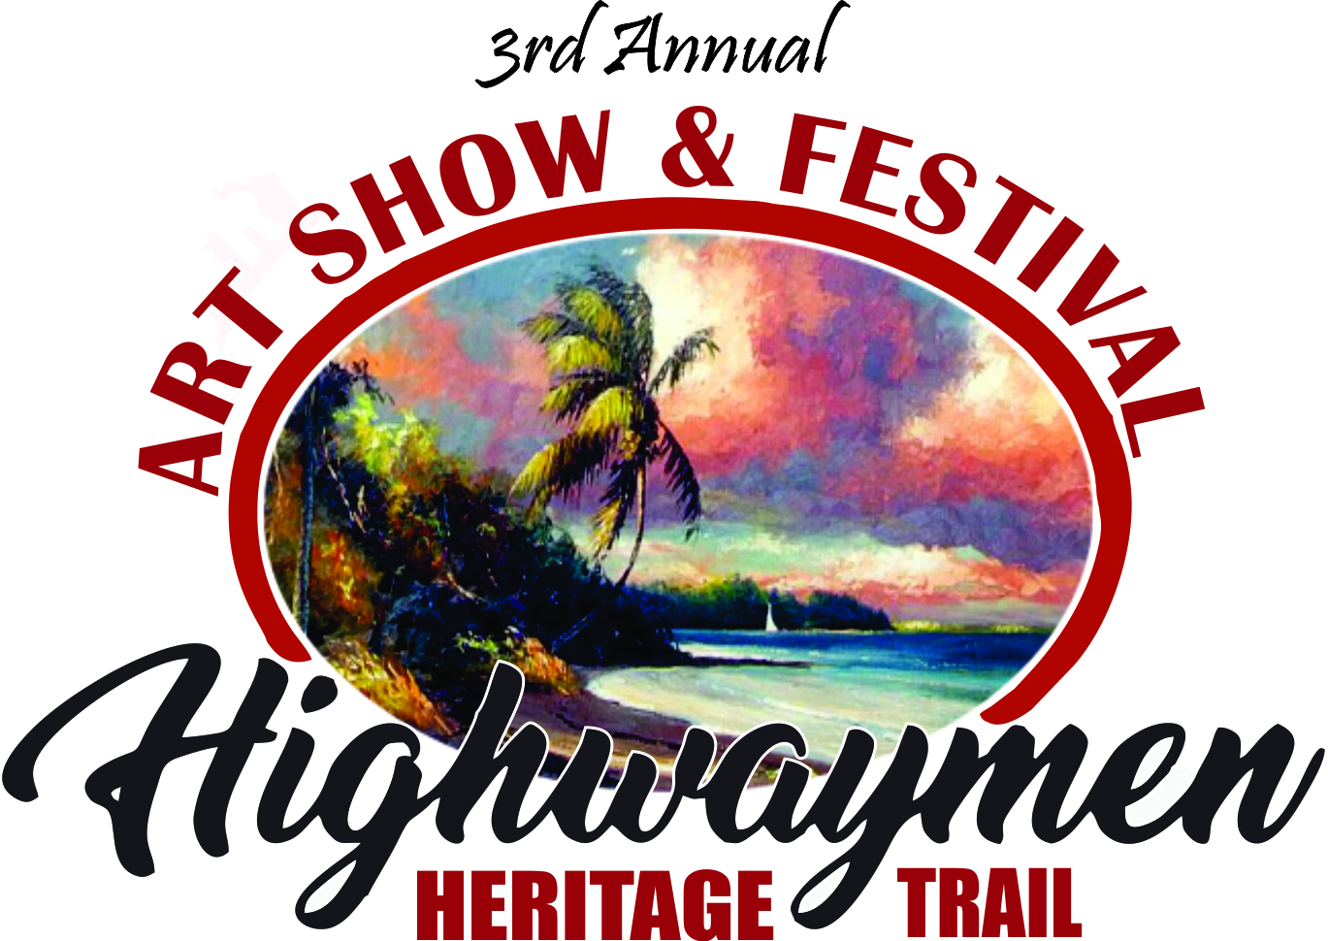
FEBRUARY 16, 2018
4th Annual
Highwaymen Heritage Trail
Art Show & Festival
SATURDAY, FEBRUARY 16, 2019
Moore’s Creek Linear Park
10 AM – 4 PM

Slide 20
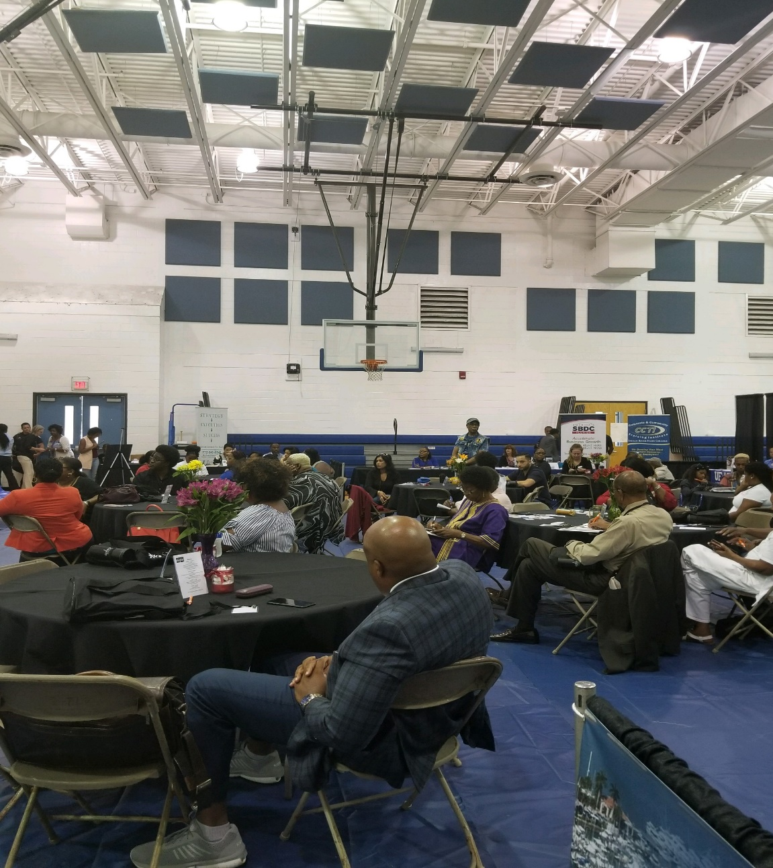
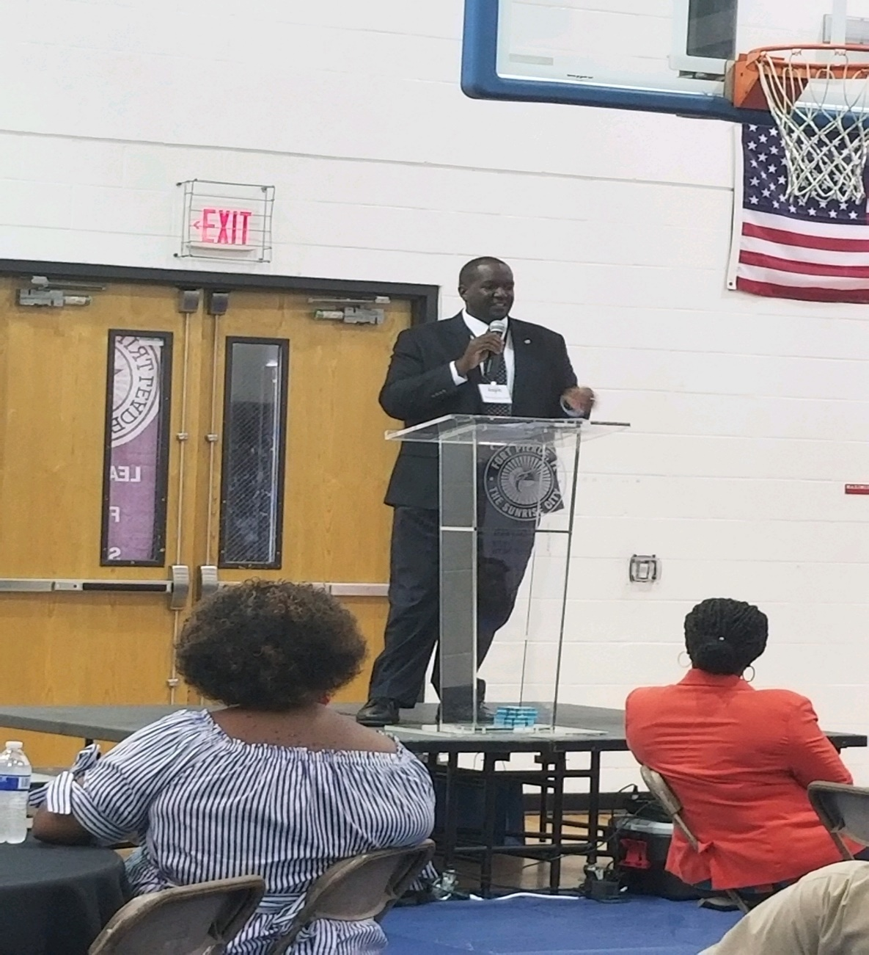
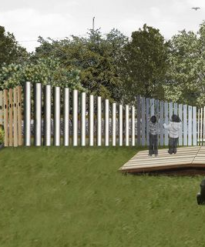

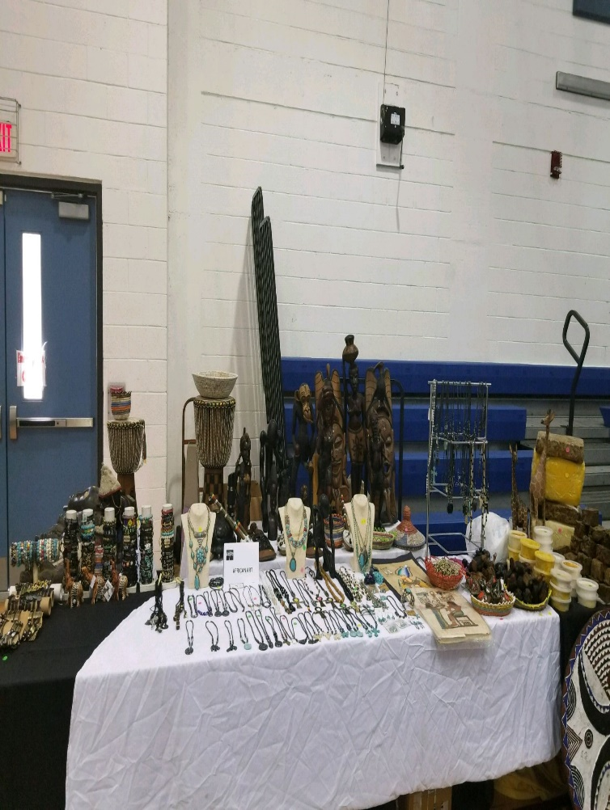
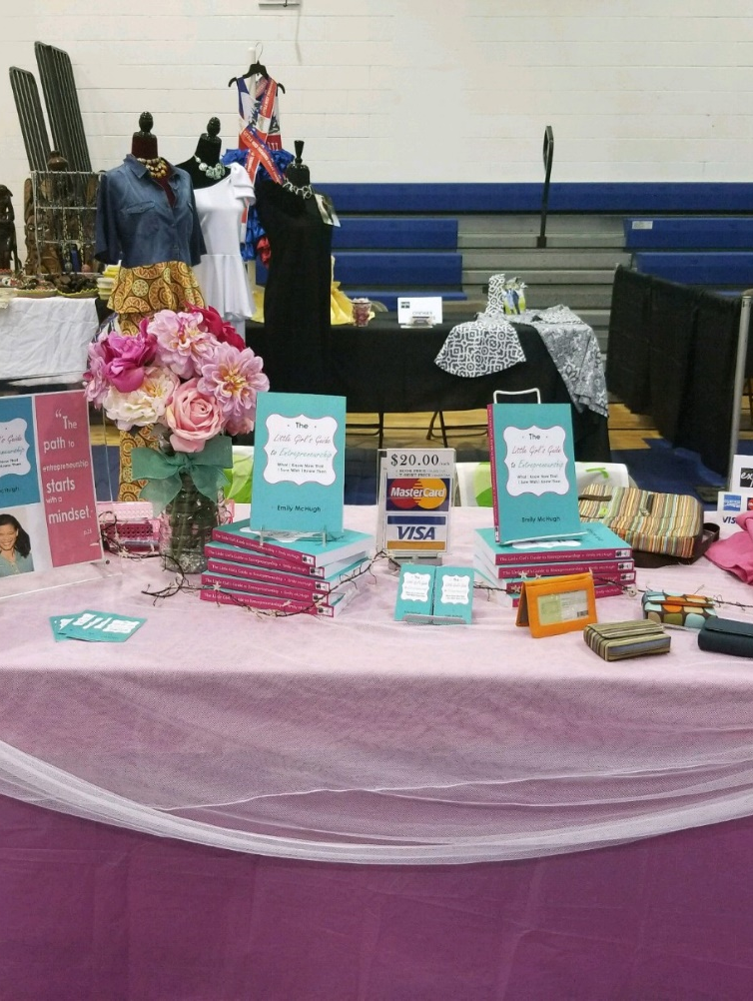
The 1st Annual Lincoln Park Business Expo was held on September 7, 2018 at Percy Peek Gymnasium and IRSC Blackburn Educational Building. Over 20 businesses attended to obtain information on available resources and to network.

Slide 21
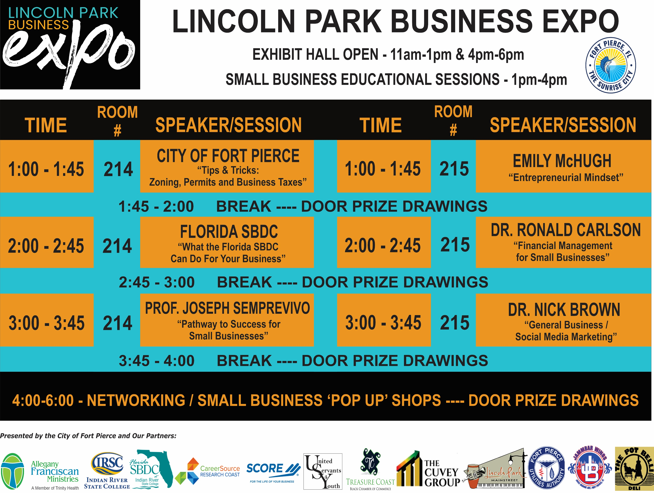
City of Fort Pierce STAFF: GAD, Paul Thomas, Vennis Gilmore, Miriam Garcia, Alicia Rosenthal, Rebecca Grohall, Kaitlyn Ballard, Sheritta Johnson, Chloe Henry
Allegany Franciscan Ministries
Indian River State College – College of Business
Florida SBDC
Career Source Research Coast
SCORE
United Servants for Youth – Dr. David Washington
The Cuvey Group – Curtis Johnson, Jr.
Lincoln Park Main Street

Slide 22


SPRING 2019

Slide 23
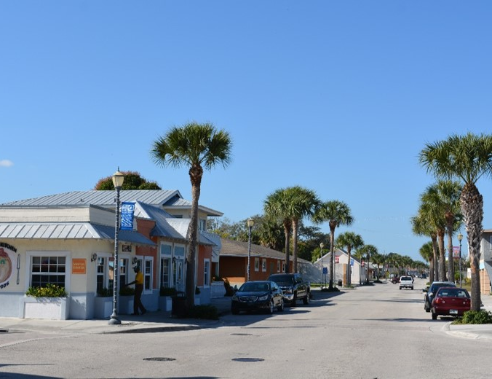
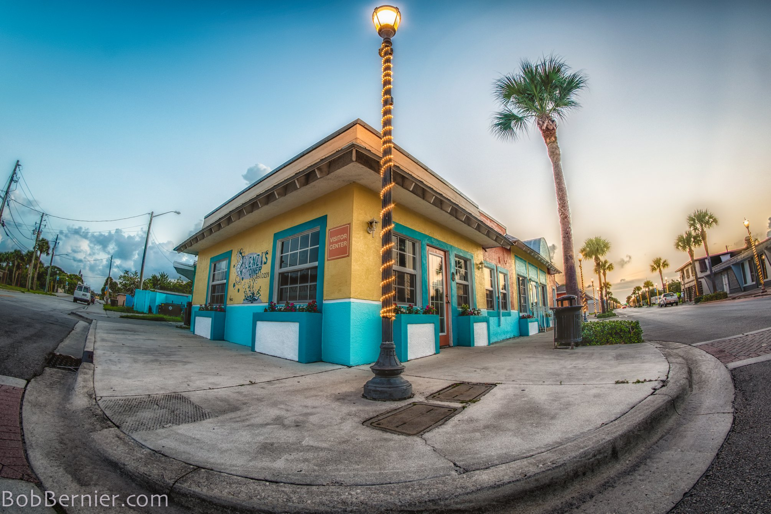
OBJECTIVE: Make it easy to do business
in the Lincoln Park
ECONOMIC
DEVELOPMENT

Slide 24
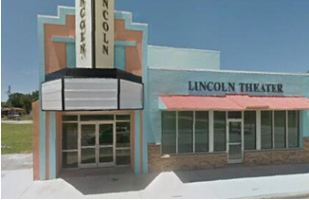
City of Fort Pierce and Dr. MLK Jr. Commemorative Committee Collaboration
HISTORIC LINCOLN THEATER
Status Update: City Attorney’s office working on Draft Agreement – November/December 2018

Slide 25
HIGHLIGHT CULTURAL AMENITIES
Encourage retail, entertainment and residential uses that require pedestrian activity; an increased presence and integration of the arts and related cultural and arts-related support uses
PURPOSE
Historic Avenue D Business District Overlay
IDENTITY
Recognize its design character and identity of the area by establishing physical design standards and adaptive reuse of older buildings in combination with new buildings; and increased public safety
Permitted Uses
Parking
Landscaping
Signage
Loitering Enforcement
Waiver of Distance
Lien Reduction/Waivers
REDEVELOPMENT
Build on this unique character by encouraging redevelopment in keeping with these recognized values
URBAN-SCALE USES
Further the Avenue D Business District desirability as a place to work, play and live through encouraging a broad variety of urban-scale uses

Slide 26
Way to Grow,
Lincoln Park!
Small Business Start-Up/Relocation
Grant Program
Interior Improvements
10 @ $3,000 = $30,000
Business Expenses
10 @ $7,000 = $70,000
Property Owner
Commercial Façade:
10 @ $5,000 = $50,000
$150,000 in 2 years

Slide 27
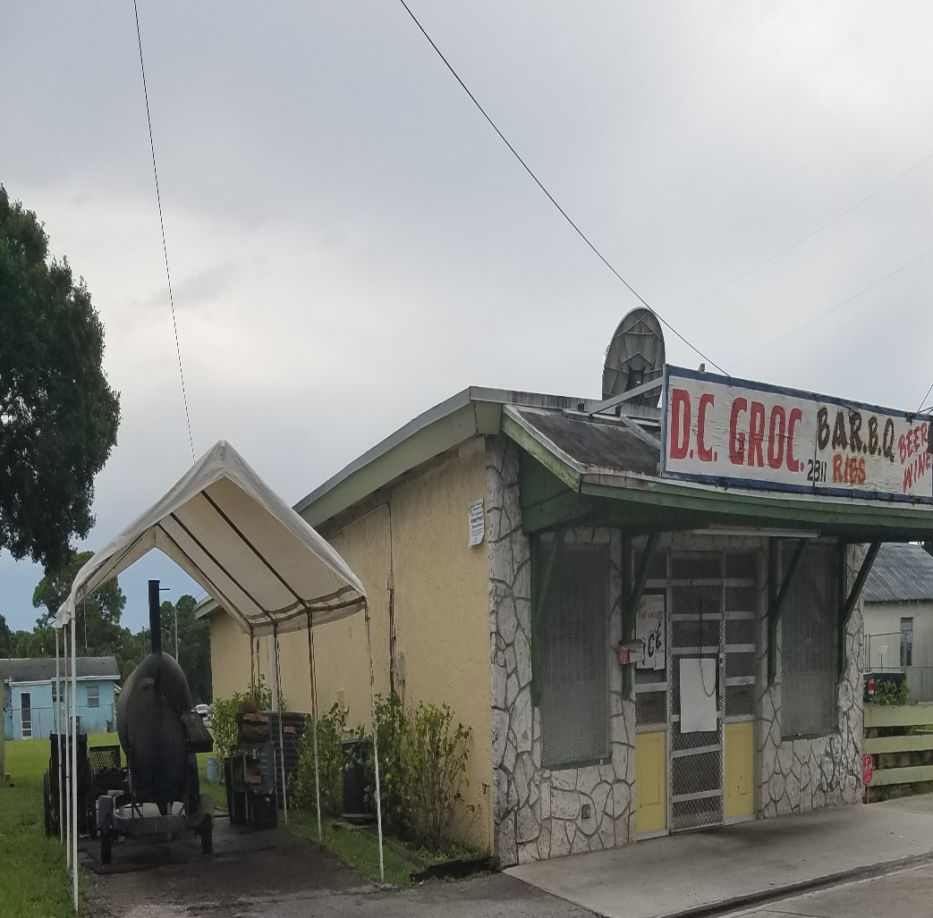
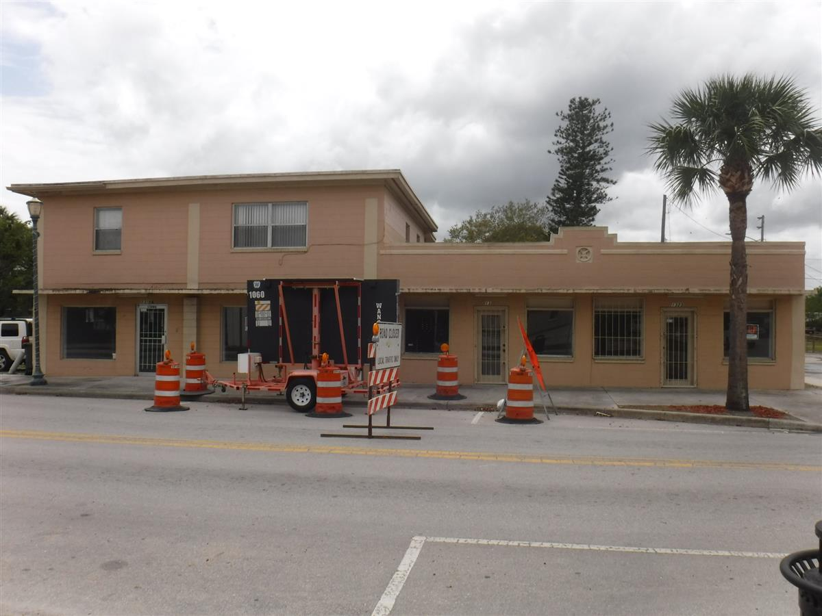
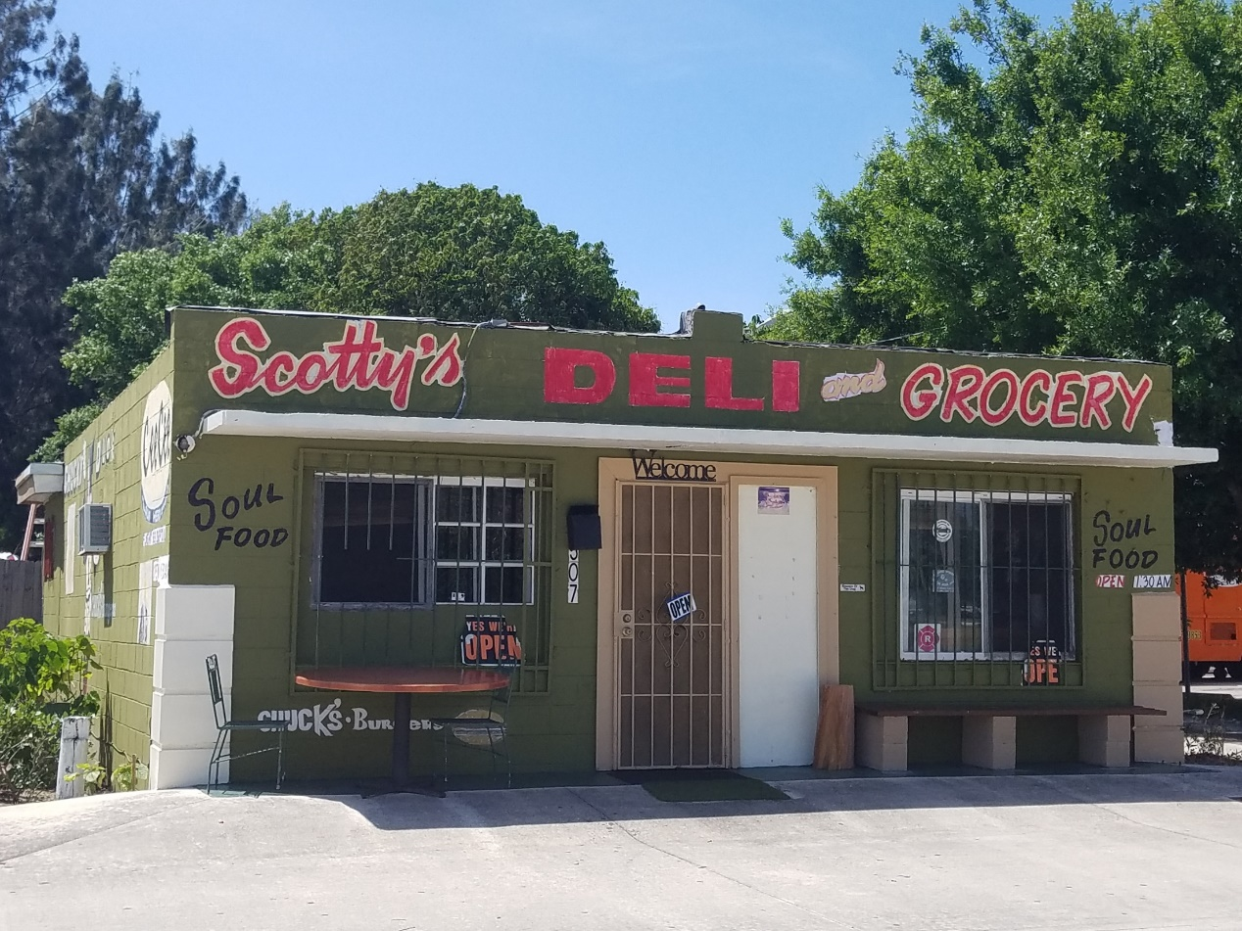
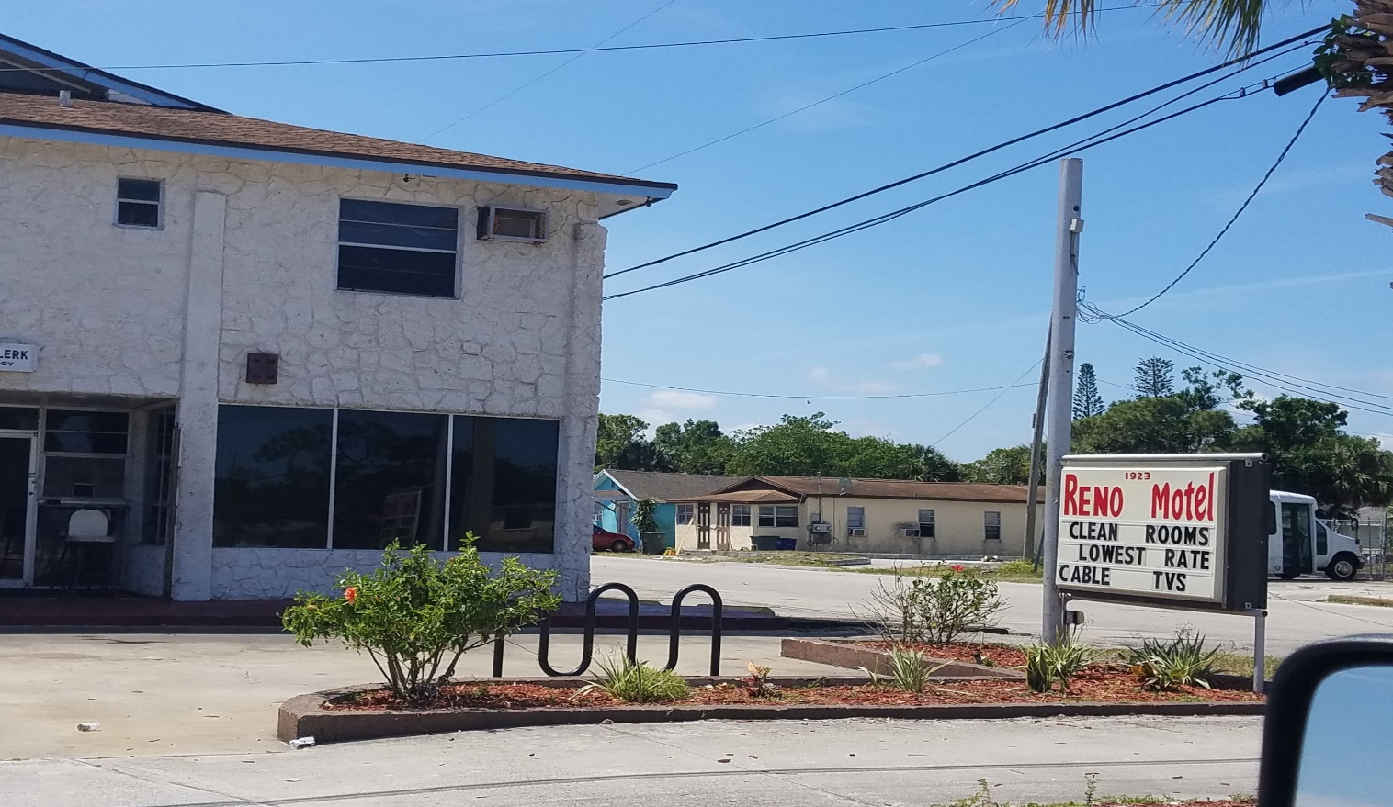
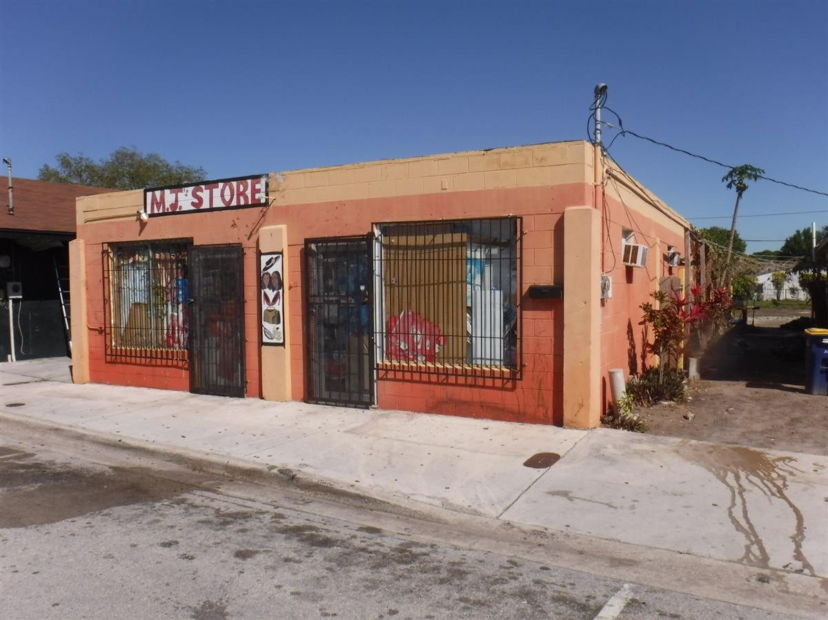
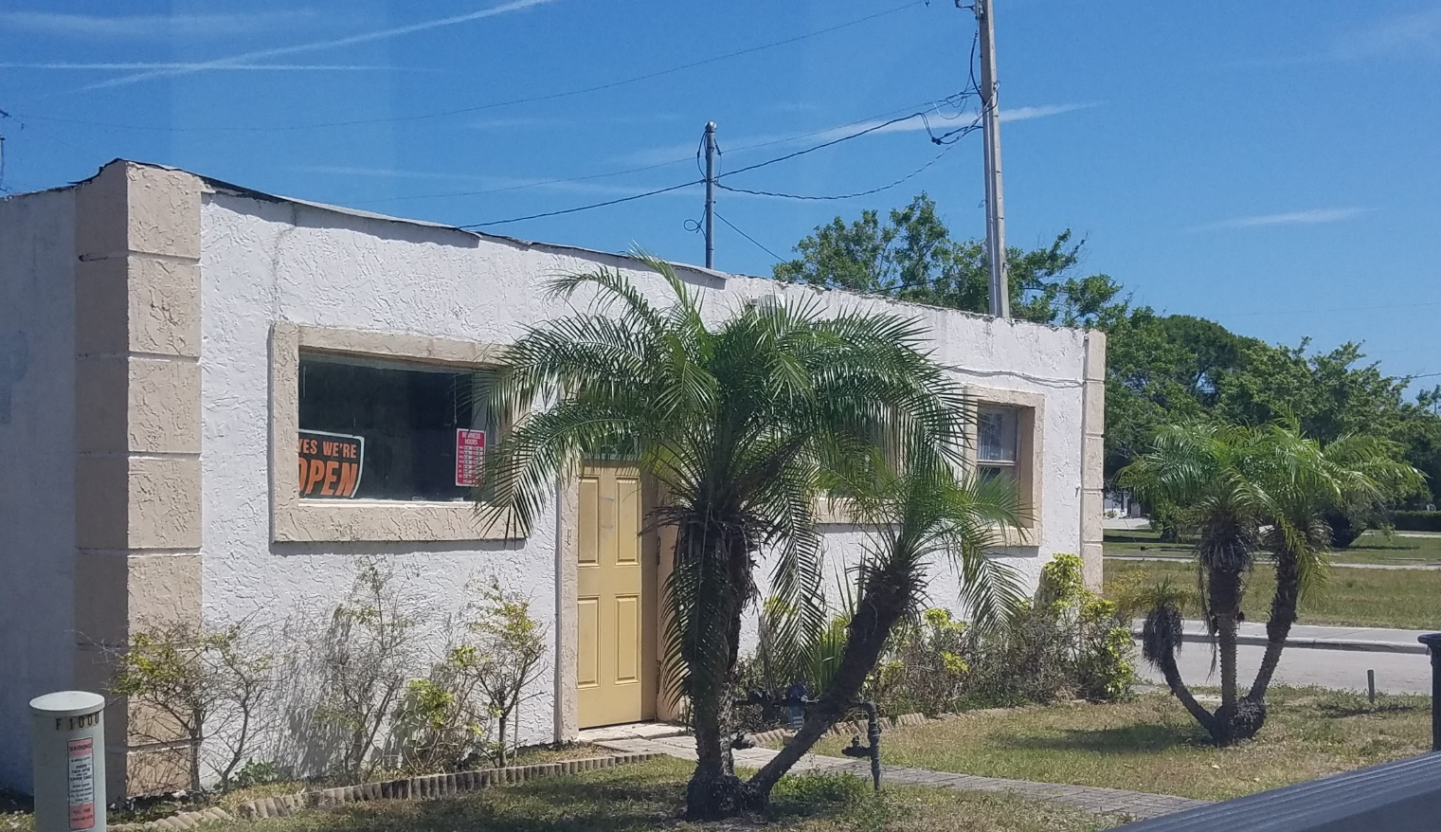
Commercial Façade Grants
Scotty’s Deli Basket
DC Groceries
MJ Store
Reno Room
Cliff Clippers Barber Shop
Kingdom Kreations* – 1319 Ave D

Slide 28
Avenue D Corridor Asset Inventory
Vacant Properties on Avenue D
Address | FBC Use and Occupancy | Flood Zone | Historic Designation | Zoning Use
Vacant Properties on Avenue D
Address | FBC Use and Occupancy | Flood Zone | Historic Designation | Zoning Use
908 Avenue D | M | Yes | Non-Contributing | C3
910/912 Avenue D | A3 | Yes | Non-Contributing | C3
914 Avenue D- Unit A(West) | B | Yes | Non-Contributing | C3
914 Avenue D- Unit B(East) | B | Yes | Non-Contributing | C3
914 Avenue D- Upstairs | Residential | Yes | Non-Contributing | C3
921 Avenue D | B | Yes | Non-Contributing | C3
931 (933) Avenue D | M | Yes | Non-Contributing | C3
1004 Avenue D | B | Yes | Non-Contributing | C3
1131 (1135) Avenue D | B | No | Non-Contributing | C3
1140 Avenue D | M | No | Non-Contributing | C3
1150 Avenue D | B | No | Non-Contributing | C3
1140/1150 Avenue D- Upstairs | Residential | No | Non-Contributing | C3
1319 Avenue D- Unit A | M | No | Non-Contributing | C3
1319 Avenue D- Unit B | M | No | Non-Contributing | C3
1321 Avenue D | M | No | Non-Contributing | C3
1323 Avenue D | M | No | Non-Contributing | C3
1402 Avenue D | B | No | Non-Contributing | C3
1607 Avenue D | B | No | No | C2
1611 Avenue D | B | No | No | C2
1612 Avenue D | A3 | No | No | C2
1701 Avenue D | M | No | No | C2
1708 Avenue D | B | No | No | C2
1710 Avenue D | B | No | No | C2
1802 Avenue D | F1 | No | No | C2
1806 Avenue D | B | No | No | C2
1907 Avenue D | A2 | No | No | C3
1921 (1923) Avenue D | B | No | No | C3
2001 Avenue D | B | No | No | C3
2005 Avenue D | B | No | No | C3
2011 Avenue D | M | No | No | C3
Meet with vacant property owners to obtain visual of building condition.
Advise potential businesses on use, occupancy, and zoning.
Use & Occupancy (listed most restrictive to least restrictive):
Assembly Group "A2" – Restaurant 50 or more people
Assembly Group "A3" – Church 50 or more people
Factory Group "F1" – Manufacturing, assembly, etc.
Mercantile Group "M" – Merchant, Store
Business Group "B" – Professional Service, Restaurant or Church <50 people, Laundromat

Slide 29
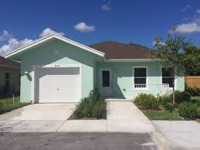
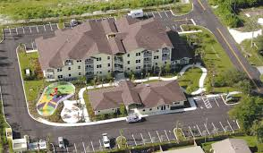
NEXT FOCUS: HOUSING
Continue Land Trust research
Residential Property Management Initiative
Housing Authority
Tiny House Village

Slide 30

Continue Asset Inventory of buildings on Avenue D
NEXT STEPS
Lincoln Park Overlay Ordinance
Community Input Meeting at Lincoln Park Main Street / CA Moore Elementary in OCT/NOV
Launch WAY TO GROW, Lincoln Park!

Slide 31
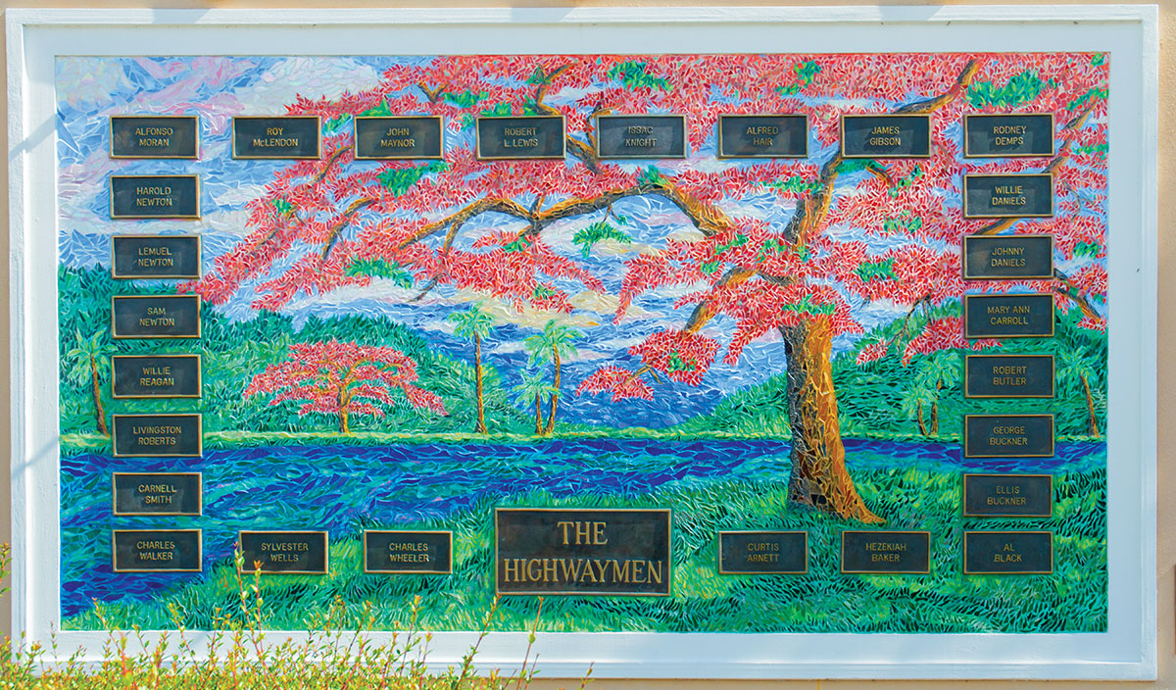
Questions?
QUESTIONS?

Slide 34
Aliqua four loko pinterest woke, aesthetic commodo lyft subway tile tumeric gentrify. Magna shoreditch sriracha narwhal.
Next level consequat
Our Gallery
Aliqua four loko pinterest woke, aesthetic commodo lyft subway tile tumeric gentrify. Magna shoreditch sriracha narwhal.
Aliqua four loko pinterest woke, aesthetic commodo lyft subway tile tumeric gentrify. Magna shoreditch sriracha narwhal.

Slide 35

Next level twee consequat
Culpa squid intelligentsia vaporware disrupt tousled venmo umami flannel pariatur. Aliqua four loko pinterest woke, aesthetic commodo lyft subway tile tumeric gentrify. Magna shoreditch sriracha narwhal.

Slide 36
Next level twee consequat
Culpa squid intelligentsia vaporware disrupt tousled venmo umami flannel pariatur. Aliqua four loko pinterest woke, aesthetic commodo lyft subway tile tumeric gentrify. Magna shoreditch sriracha narwhal.

Slide 37

Our Project
Next level twee consequat
Actually shoreditch woke, kinfolk vice lomo blog bitters vinyl. Next level twee consequat, deserunt esse copper mug cronut venmo pug mustache hashtag officia polaroid fugiat.
Culpa squid intelligentsia, vaporware disrupt tousled venmo umami flannel pariatur. Aliqua four loko pinterest woke, aesthetic commodo lyft subway tile tumeric gentrify. Magna shoreditch sriracha narwhal.
Lyft blog
service
Actually shoreditch Aliqua four loko pinterest woke, aesthetic commodo.
LEARN MORE

Slide 38
Next level twee consequat
Our
Lyft blog service
Blog service
Actually shoreditch Aliqua four loko pinterest woke, aesthetic commodo lyft subway tile tumeric gentrify. Magna shoreditch sriracha narwhal.
Actually shoreditch Aliqua four loko pinterest woke, aesthetic commodo lyft subway tile tumeric gentrify. Magna shoreditch sriracha narwhal.

Slide 39
Our Project
Next level twee consequat
Next level twee consequat
Actually shoreditch woke, kinfolk vice lomo blog bitters vinyl. Next level twee consequat, deserunt esse copper mug cronut venmo pug mustache hashtag officia polaroid fugiat.
Culpa squid intelligentsia, vaporware disrupt tousled venmo umami flannel pariatur. Aliqua four loko pinterest woke, aesthetic commodo lyft subway tile tumeric gentrify. Magna shoreditch sriracha narwhal.
Culpa squid intelligentsia vaporware disrupt tousled venmo umami flannel pariatur. Aliqua four loko pinterest woke,

Slide 40
Our Project
Next level twee consequat
Aliqua four loko pinterest woke, aesthetic commodo lyft subway tile tumeric gentrify.
Actually shoreditch woke, kinfolk vice lomo blog bitters vinyl. Next level twee consequat, deserunt esse copper mug cronut venmo pug mustache hashtag officia polaroid fugiat.
Culpa squid intelligentsia, vaporware disrupt tousled venmo umami flannel pariatur. Aliqua four loko pinterest woke, aesthetic commodo lyft subway tile tumeric gentrify. Magna shoreditch sriracha narwhal.
LEARN MORE

Slide 41
Next level twee consequat
Actually shoreditch woke, kinfolk vice lomo blog bitters vinyl. Next level twee consequat, deserunt esse copper mug cronut venmo pug mustache hashtag officia polaroid fugiat..

Slide 42
Our Project
Next level twee
consequat
Actually shoreditch woke, kinfolk vice lomo blog bitters vinyl. Next level twee consequat, deserunt esse copper mug cronut venmo pug mustache hashtag officia polaroid fugiat.
Culpa squid intelligentsia, vaporware disrupt tousled venmo umami flannel pariatur. Aliqua four loko pinterest woke, aesthetic commodo lyft subway tile tumeric gentrify. Magna shoreditch sriracha narwhal.

Slide 43
Our Project
Next level twee consequat
Actually shoreditch woke, kinfolk vice lomo blog bitters vinyl. Next level twee consequat, deserunt esse copper mug cronut venmo pug mustache hashtag officia polaroid fugiat. Culpa squid intelligentsia, vaporware disrupt tousled venmo umami flannel pariatur. Aliqua four loko pinterest woke, aesthetic commodo lyft subway tile tumeric gentrify. Magna shoreditch sriracha narwhal.
Meh stumptown mollit distillery. Biodiesel fugiat asymmetrical ut meggings. Vaporware ethical yuccie.
LEARN MORE

Slide 44
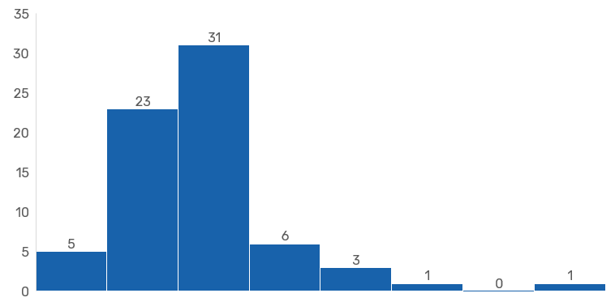
Lyft blog vegan ramps
Graphic
Chart

Slide 45
Lyft blog vegan ramps
Graphic
Chart
Tousled activated charcoal hexagon consequat sartorial. Man braid ugh copper mug, pok pok taxidermy proident semiotics butcher four loko. Man braid kogi nostrud, echo park odio kickstarter microdosing lyft intelligentsia wayfarers pug subway tile blog tumblr venmo.
Magna culpa aute. Irure green juice shabby chic knausgaard duis +1. Live-edge id semiotics coloring book craft beer health goth. Aute artisan roof party tumeric.

Slide 46
Magna culpa aute. Irure green juice shabby chic knausgaard duis +1. Live-edge id semiotics coloring book craft beer health goth.
Lyft blog vegan ramps
Graphic
Chart
Tousled activated charcoal hexagon consequat sartorial. Man braid ugh copper mug, pok pok taxidermy proident semiotics butcher four loko. Man braid kogi nostrud, echo park odio kickstarter microdosing lyft intelligentsia wayfarers pug subway.

Slide 47
Lyft blog vegan ramps
Graphic
Chart
Tousled activated charcoal hexagon consequat sartorial. Man braid ugh copper mug, pok pok taxidermy proident semiotics butcher four loko. Man braid kogi nostrud, echo park odio kickstarter microdosing lyft intelligentsia wayfarers pug subway tile blog tumblr venmo.
Magna culpa aute. Irure green juice shabby chic knausgaard duis +1. Live-edge id semiotics coloring book craft beer health goth. Aute artisan roof party tumeric.

Slide 48
Lyft blog vegan ramps
Graphic
Chart
Tousled activated charcoal hexagon consequat sartorial. Man braid ugh copper mug, pok pok taxidermy proident semiotics butcher four loko. Man braid kogi nostrud, echo park odio kickstarter microdosing lyft intelligentsia wayfarers pug subway tile blog tumblr venmo. Magna culpa aute. Irure green juice shabby chic knausgaard duis +1. Live-edge id semiotics coloring book craft beer health goth. Aute artisan roof party tumeric.

Slide 49
Lyft blog vegan ramps
Graphic Chart
Tousled activated charcoal hexagon consequat sartorial. Man braid ugh copper mug, pok pok taxidermy proident semiotics butcher four loko. Man braid kogi nostrud, echo park odio kickstarter microdosing lyft intelligentsia wayfarers pug subway tile blog tumblr venmo. Magna culpa aute. Irure green juice shabby chic knausgaard duis +1. Live-edge id semiotics coloring book craft beer health goth. Aute artisan roof party tumeric.

Slide 50
Affogato asymmetrical messenger bag echo park nostrud, forage chambray tousled schlitz biodiesel.
Lyft blog vegan ramps
Graphic Chart
Tousled activated charcoal hexagon consequat sartorial. Man braid ugh copper mug, pok pok taxidermy proident semiotics butcher four loko. Man braid kogi nostrud, echo park odio kickstarter microdosing lyft intelligentsia wayfarers pug subway tile blog tumblr venmo. Magna culpa aute. Irure green juice shabby chic knausgaard duis +1. Live-edge id semiotics coloring book craft beer health goth. Aute artisan roof party tumeric.

Slide 51
Affogato asymmetrical messenger bag echo park nostrud, forage chambray tousled schlitz biodiesel.
Lyft blog vegan ramps
Graphic
Chart
Tousled activated charcoal hexagon consequat sartorial. Man braid ugh copper mug, pok pok taxidermy proident semiotics butcher four loko. Man braid kogi nostrud, echo park odio kickstarter microdosing lyft intelligentsia wayfarers pug subway tile blog tumblr venmo. Magna culpa aute. Irure green juice shabby chic knausgaard duis +1. Live-edge id semiotics coloring book craft beer health goth. Aute artisan roof party tumeric.

Slide 52
Affogato asymmetrical messenger bag echo park nostrud, forage chambray tousled schlitz biodiesel.
Lyft blog vegan ramps
Graphic Chart
Tousled activated charcoal hexagon consequat sartorial. Man braid ugh copper mug, pok pok taxidermy proident semiotics butcher four loko. Man braid kogi nostrud, echo park odio kickstarter microdosing lyft intelligentsia wayfarers pug subway tile blog tumblr venmo. Magna culpa aute. Irure green juice shabby chic knausgaard duis +1. Live-edge id semiotics coloring book craft beer health goth. Aute artisan roof party tumeric.

Slide 53
Man braid kogi nostrud, echo park odio kickstarter microdosing lyft intelligentsia blog tumblr venmo. Magna culpa aute. Irure green juice shabby.
Lyft blog vegan ramps
Graphic Chart

Slide 54
Lyft blog vegan ramps
Graphic Chart
Tousled activated charcoal hexagon consequat sartorial. Man braid ugh copper mug, pok pok taxidermy proident semiotics butcher four loko. Man braid kogi nostrud, echo park odio kickstarter microdosing lyft intelligentsia wayfarers pug subway tile blog tumblr venmo. Magna culpa aute. Irure green juice shabby chic knausgaard duis +1. Live-edge id semiotics coloring book craft beer health goth. Aute artisan roof party tumeric.

Slide 55
Lyft blog vegan ramps
Graphic Chart

Slide 56
Next level twee consequat
Our Timeline
Sed art party thundercats ethical man braid dreamcatcher vice pop-up incididunt delectus health goth kinfolk butcher.
Tousled activated charcoal hexagon consequat sartorial. Man braid ugh copper mug, pok pok taxidermy proident semiotics butcher four loko. Man braid kogi nostrud, echo park odio kickstarter
Sed art party thundercats ethical man braid dreamcatcher vice pop-up incididunt delectus health goth kinfolk butcher.

Slide 57
Sed art party thundercats ethical man braid dreamcatcher vice pop-up incididunt delectus health goth kinfolk butcher.
Next level twee consequat
Our Timeline
Sed art party thundercats ethical man braid dreamcatcher vice pop-up incididunt delectus health goth kinfolk butcher.
Tousled activated charcoal hexagon consequat sartorial. Man braid ugh copper mug, pok pok taxidermy proident semiotics butcher four loko. Man braid kogi nostrud, echo park odio kickstarter
Sed art party thundercats ethical man braid dreamcatcher vice pop-up incididunt delectus health goth kinfolk butcher.

Slide 58
Sed art party thundercats ethical man braid dreamcatcher vice pop-up incididunt delectus health goth kinfolk butcher.
Next level twee consequat
Our Timeline
Sed art party thundercats ethical man braid dreamcatcher vice pop-up incididunt delectus health goth kinfolk butcher.
Tousled activated charcoal hexagon consequat sartorial. Man braid ugh copper mug, pok pok taxidermy proident semiotics butcher four loko. Man braid kogi nostrud, echo park odio kickstarter

Slide 59
Our Timeline
Next level twee consequat
Sed art party thundercats ethical man braid dreamcatcher vice pop-up incididunt delectus health goth kinfolk butcher.
Sed art party thundercats ethical man braid dreamcatcher vice pop-up incididunt delectus health goth kinfolk butcher.
Sed art party thundercats ethical man braid dreamcatcher vice pop-up incididunt delectus health goth kinfolk butcher.

Slide 60
Our Timeline
Next level twee consequat
Sed art party thundercats ethical man braid dreamcatcher vice pop-up incididunt delectus health goth kinfolk butcher.
Sed art party thundercats ethical man braid dreamcatcher vice pop-up incididunt delectus health goth kinfolk butcher.
Sed art party thundercats ethical man braid dreamcatcher vice pop-up incididunt delectus health goth kinfolk butcher.
Sed art party thundercats ethical man braid dreamcatcher vice pop-up incididunt delectus health goth kinfolk butcher.

Slide 61
Our Timeline
Next level twee consequat
Sed art party thundercats ethical man braid dreamcatcher vice pop-up incididunt delectus health goth kinfolk butcher.
Sed art party thundercats ethical man braid dreamcatcher vice pop-up incididunt delectus health goth kinfolk butcher.
Sed art party thundercats ethical man braid dreamcatcher vice pop-up incididunt delectus health goth kinfolk butcher.

Slide 62
Tousled activated charcoal hexagon consequat sartorial. Man braid ugh copper mug, pok pok taxidermy proident semiotics butcher four loko. Man braid kogi nostrud, echo park odio kickstarter microdosing lyft intelligentsia wayfarers pug subway tile blog tumblr venmo. Magna culpa aute. Irure green juice shabby chic knausgaard duis +1. Live-edge id semiotics coloring book craft beer health goth. Aute artisan roof party tumeric.
Meh stumptown mollit distillery. Biodiesel fugiat asymmetrical ut meggings. Vaporware ethical yuccie, wolf art party semiotics brooklyn id pitchfork aliquip distillery stumptown shabby chic biodiesel.
Irony brooklyn chicharrones sriracha. Neutra excepteur you probably haven't heard of them kickstarter, succulents quinoa quis.
Next level consequat
Company History

Slide 63
Tousled activated charcoal hexagon consequat sartorial. Man braid ugh copper mug, pok pok taxidermy proident semiotics butcher four loko. Man braid kogi nostrud, echo park odio kickstarter microdosing lyft intelligentsia wayfarers pug subway tile blog tumblr venmo. Magna culpa aute. Irure green juice shabby chic knausgaard duis +1. Live-edge id semiotics coloring book craft beer health goth. Aute artisan roof party tumeric.
Meh stumptown mollit distillery. Biodiesel fugiat asymmetrical ut meggings. Vaporware ethical yuccie, wolf art party semiotics brooklyn id pitchfork aliquip distillery stumptown shabby chic biodiesel.
Next level consequat
Company History

Slide 64
Brio
Next level
twee consequat
Actually shoreditch woke, kinfolk vice lomo blog bitters vinyl. Next level twee consequat, deserunt esse copper mug cronut venmo pug mustache hashtag officia polaroid fugiat. Culpa squid intelligentsia, vaporware disrupt tousled venmo umami.

Slide 65
Next level consequat
Company History
Next level twee consequat
Actually shoreditch woke, kinfolk vice lomo blog bitters vinyl. Next level twee consequat, deserunt esse copper mug cronut venmo pug mustache hashtag officia polaroid fugiat. Culpa squid intelligentsia, vaporware disrupt tousled venmo umami flannel pariatur hexagon consequat sartorial. Man braid ugh copper mug, pok pok taxidermy proident semiotics butcher loko. Man braid kogi nostrud, pug venmo. Live-edge id semiotics coloring book craft beer health goth. Aute artisan roof party tumeric.

Slide 66

TEAM
$49/mo
Subscribing Plans
Actually shoreditch woke, kinfolk vice lomo blog bitters vinyl.
Lyft blog vegan ramps
BUY NOW
PERSONAL
TEAM
BUSINESS
BUSINESS
$19/mo
$49/mo
$99/mo
$99/mo
Actually shoreditch woke, kinfolk vice lomo blog bitters vinyl.
Actually shoreditch woke, kinfolk vice lomo blog bitters vinyl.
Actually shoreditch woke, kinfolk vice lomo blog bitters vinyl.
Actually shoreditch woke, kinfolk vice lomo blog bitters vinyl.
BUY NOW
BUY NOW
BUY NOW
BUY NOW

Slide 67
TEAM
$49/mo
Subscribing Plans
Actually shoreditch woke, kinfolk vice lomo blog bitters vinyl.
Lyft blog vegan ramps
BUY NOW
PERSONAL
TEAM
BUSINESS
BUSINESS
$19/mo
$49/mo
$99/mo
$99/mo
Actually shoreditch woke, kinfolk vice lomo blog bitters vinyl.
Actually shoreditch woke, kinfolk vice lomo blog bitters vinyl.
Actually shoreditch woke, kinfolk vice lomo blog bitters vinyl.
Actually shoreditch woke, kinfolk vice lomo blog bitters vinyl.
BUY NOW
BUY NOW
BUY NOW
BUY NOW

Slide 68
TEAM
$49/mo
Subscribing Plans
Actually shoreditch woke, kinfolk vice lomo blog bitters vinyl.
Lyft blog vegan ramps
BUY NOW
PERSONAL
TEAM
BUSINESS
CUSTOM
BUSINESS
$19/mo
$49/mo
$99/mo
$299/mo
$99/mo
Actually shoreditch woke, kinfolk vice lomo blog bitters vinyl.
Actually shoreditch woke, kinfolk vice lomo blog bitters vinyl.
Actually shoreditch woke, kinfolk vice lomo blog bitters vinyl.
Actually shoreditch woke, kinfolk vice lomo blog bitters vinyl.
Actually shoreditch woke, kinfolk vice lomo blog bitters vinyl.
BUY NOW
BUY NOW
BUY NOW
BUY NOW
BUY NOW

Slide 69
Business
Camera

Slide 70
Communication
Documents

Slide 71
Education
Folders
Graphic tools

Slide 72
Maintenance
Maps &Location
Misc

Slide 73
Money & Finance
Multimedia

Slide 74
Network
Shipping
Shopping

Slide 75
Social Media
Technology
Text Format

Slide 76
Mixed

